Slide 1


Modeling of Active
Aeroservoelastic Systems
Anthony Su
11/30/2023
Notes:
Name: Anthony Su
Master’s student here at the Aero+Astro department here at the University of Washington
Advisor: Professor Eli Livne
Thesis: Modeling of Active Aeroservoelastic Systems

Slide 2
Agenda
Overview
FEM & GVT
Mathematical Model
Wind Tunnel Testing
Model Tuning & Optimization
Conclusion
Notes:
Agenda
overview
FEM & GVT
math model
wind tunnel testing
model tuning and optimization
conclusion and questions
Please hold your questions until the end of the presentation (if I go on a tangent I may never return!)

Slide 3
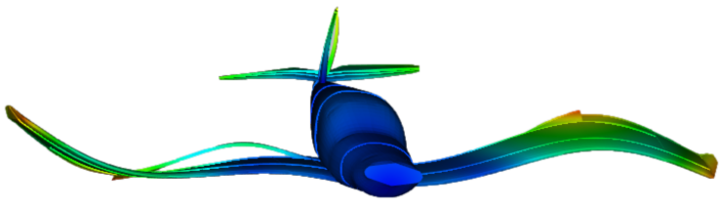
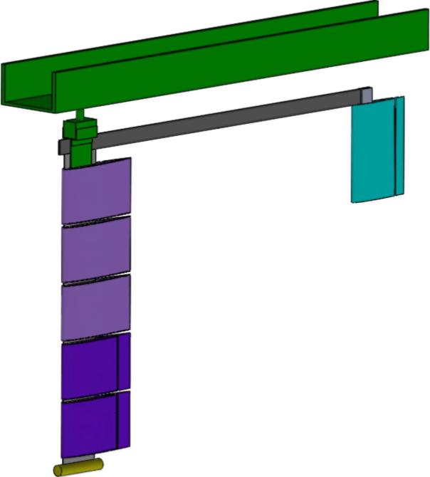
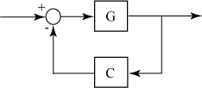
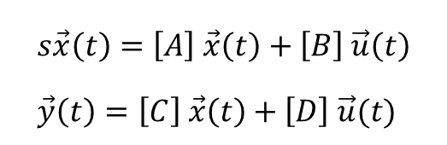
Overview
AEROSERVO-
ELASTICITY
MARGE
MODELING
Structural Dynamics
Aerodynamics
Controls
Model for Aeroelastic Response to Gust Excitation¹
Physics-based model
Required for active control
$$s\vec{x}\left(t\right)=\left[A\right] \vec{x}\left(t\right)+\left[B\right] \vec{u}\left(t\right) \\ \vec{y}\left(t\right)=\left[C\right] \vec{x}\left(t\right)+\left[D\right] \vec{u}(t)$$
https://www.m4-engineering.com/wp-content/uploads/2020/04/pynastran-2.png
Notes:
Overview
Aeroservoelasticity
structural dynamics, aerodynamics, and controls
important because energy-efficient aircraft have long, slender wings which are very flexible
the most flexible wings must actively counteract bending and twisting in real-time
MLA, GLA, and flutter suppression
MARGE
MARGE is the test article that is modeled and tested in this project
short for Model for Aeroelastic Response to Gust Excitation
Modeling
The objective of this project was to synthesize a physics-based state-space model of MARGE
Physics-based “grey-box” models are (in theory) more interpretable and generalizable than traditional black-box system identification methods
This model can then potentially be used for control design to do the aforementioned things (MLA, GLA, flutter suppression)

Slide 4
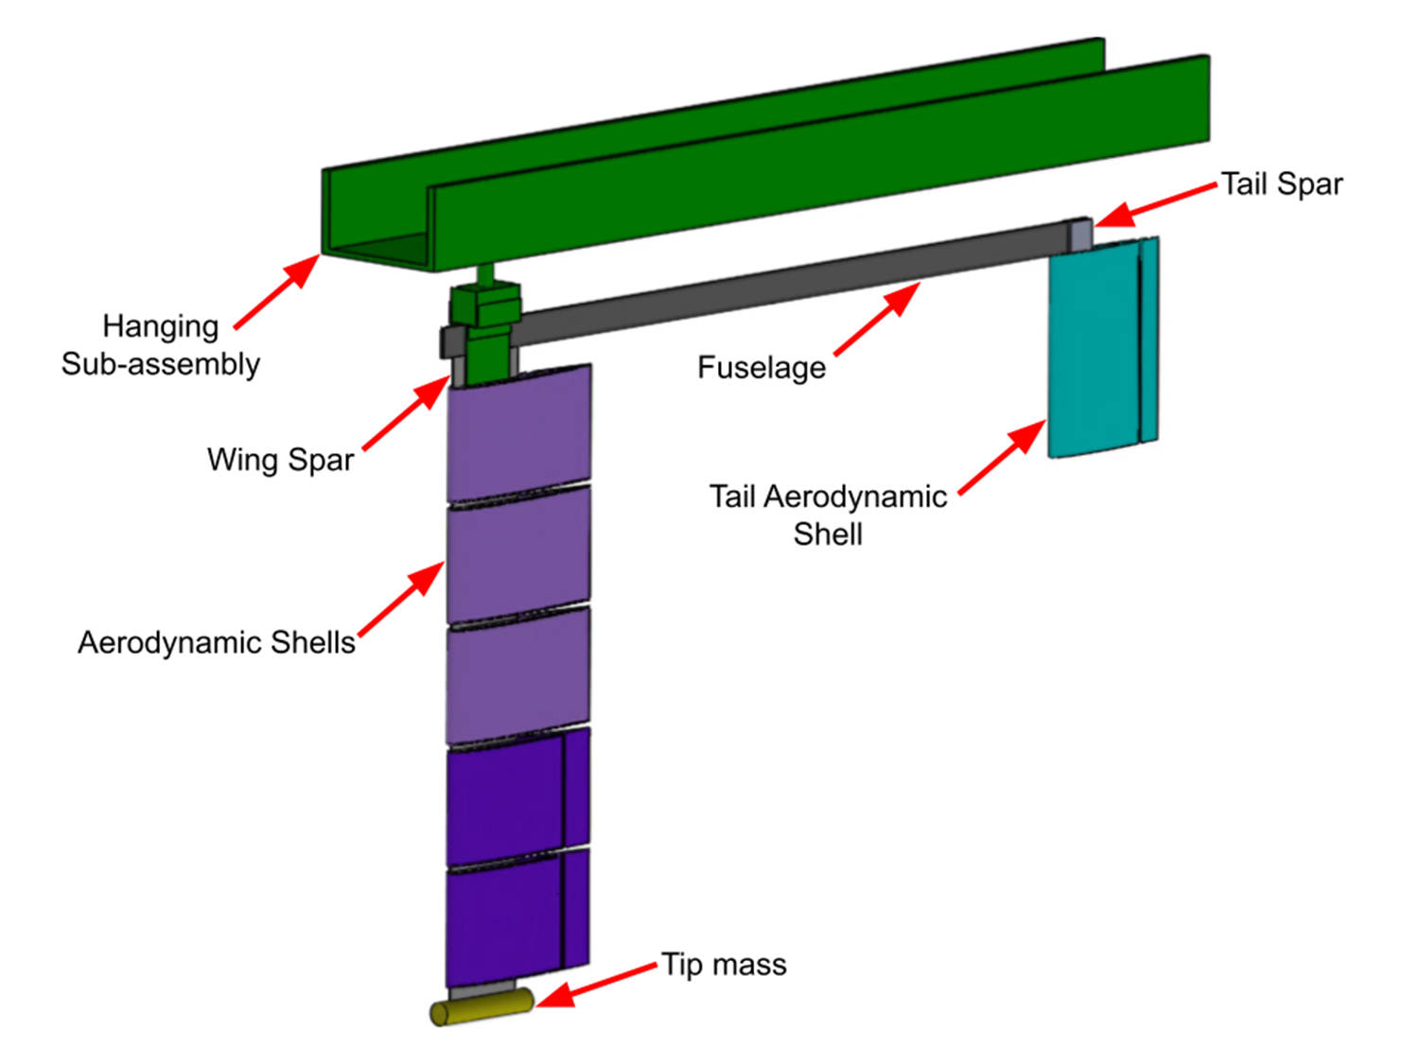
Overview
MARGE
Model for Aeroelastic Response to Gust Excitation¹
Low-cost
Highly flexible
Rotates freely in pitch
Notes:
MARGE
MARGE: “model for aeroelastic response to gust excitation”
Designed and built several years ago, see [Quenzer et. al. 2019]
it’s low-cost for an active wind tunnel model
simple flat aluminum spars
3D-printed plastic airfoil profile shells
hobby-grade servos
highly flexible
first natural frequency 1.4 Hz
rotates freely in pitch
fuselage (a beam)
wing (3D printed shells around a beam)
tail similar
brass weight on wing tip which increases inertia and reduces the natural frequencies of the wing
everything is suspended from a rigid structure, the “hanging sub-assembly”

Slide 5
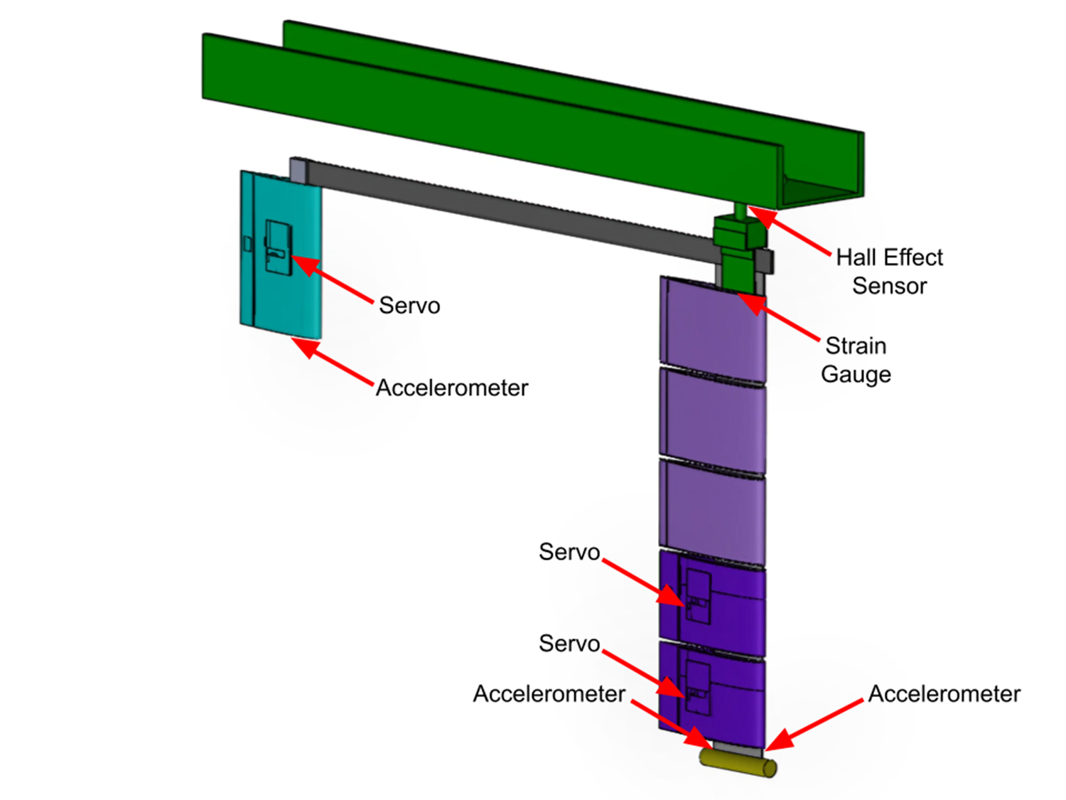
Overview
MARGE
Model for Aeroelastic Response to Gust Excitation¹
Low-cost
Highly flexible
Rotates freely in pitch
5 on-board sensors
3 on-board actuators
Notes:
5 on-board sensors
3 accelerometers
1 strain gauge in the wing root
1 hall effect sensor paired with a magnet to measure pitch angle
3 on-board actuators
2 ailerons
1 elevator

Slide 6
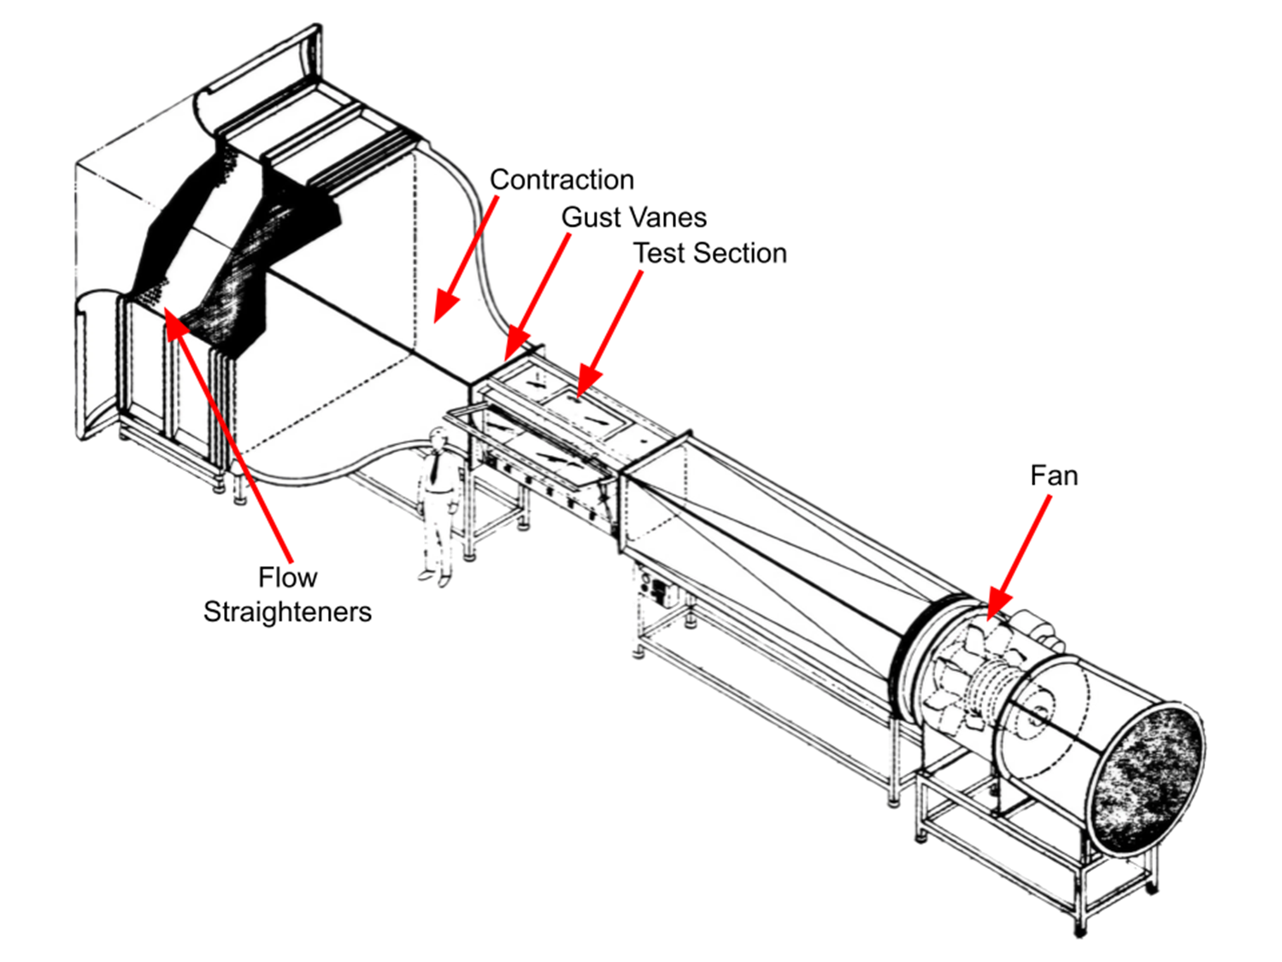
Overview
MARGE
Model for Aeroelastic Response to Gust Excitation¹
Low-cost
Highly flexible
Rotates freely in pitch
5 on-board sensors
3 on-board actuators
3x3 Wind Tunnel
Twin controllable upstream gust vanes
Notes:
3x3 wind tunnel
MARGE is designed for testing in the UW 3x3 wind tunnel
it is mounted suspended from the ceiling of the test section of the wind tunnel
Wind blows from top left to bottom right in this image
Upstream of where MARGE is mounted are two gust vanes
which can create unsteady flow fields around MARGE

Slide 7




FEM & GVT
Why?
Need structural dynamic modal information
Existing FEM was outdated
Notes:
TIME TARGET: 5 minutes
Why?
Need structural dynamic modal information
as the base for the structural dynamic model of MARGE
Existing FEM was outdated
it was made several years ago and was missing some upgraded components

Slide 8
FEM & GVT
NASTRAN FEM
Spars: Linear beam elements
Fuselage: Linear beam elements
Shells: Rigid elements
Notes:
Nastran FEM
disclaimer: I didn’t make the NASTRAN model.
spars are linear beam elements
(Euler-Bernoulli)
Fuselage is linear beam elements
Aerodynamic shells are represented by rigid elements
Concentrated masses to represent shells and other components (like actuators)

Slide 9
FEM & GVT
NASTRAN FEM
Spars: Linear beam elements
Fuselage: Linear beam elements
Shells: Rigid
Vanes: Rigid
Tunnel: Rigid
Doublet-lattice theory aerodynamics
Spline interpolation
Notes:
NASTRAN FEM
the finite-element model also included the wind tunnel test sections’ walls and the gust vanes upstream
these were all modeled with rigid elements
doublet-lattice theory is the aerodynamics model used in NASTRAN to compute the aerodynamic loads on MARGE
doublet-lattice aerodynamics is a generalization of vortex-lattice aerodynamics to unsteady flows
thus, it is a potential flow model which does not capture viscous or compressibility effects (no drag!)
no drag is ok because in aeroelasticity we mostly worry about large forces, which are mostly lift
spline interpolation
these loads are computed on the aerodynamic panels (planar surfaces shown)
to determine how they affect the structure, the loads have to be transferred to the structural model
this is done with a spline interpolation of the loads on the aerodynamic panels

Slide 10
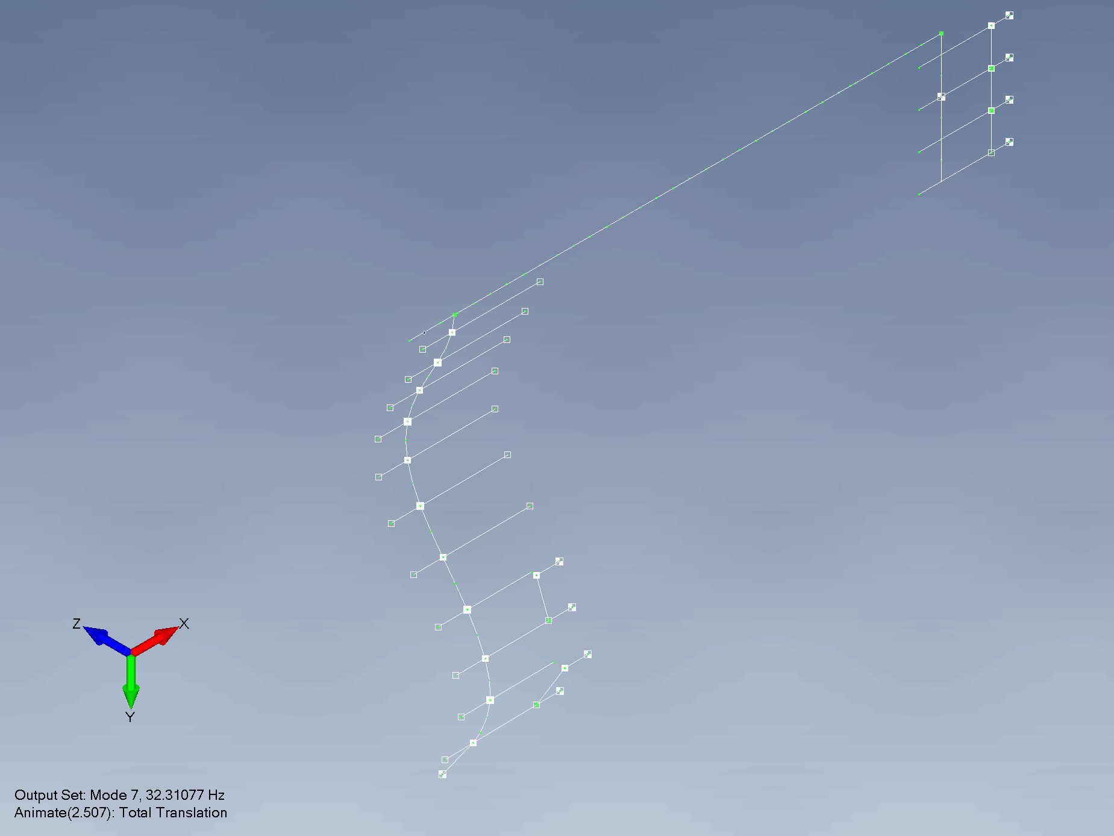
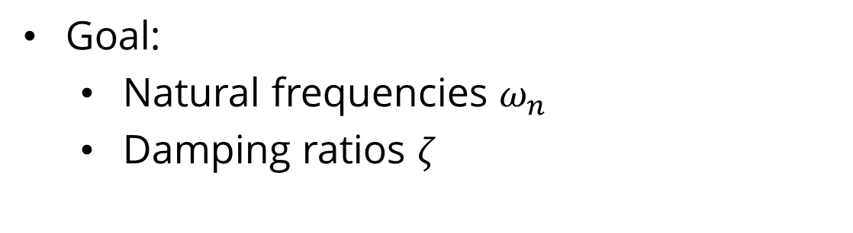
FEM & GVT
GVT
Goal:
Natural frequencies $ω_{n}$
Damping ratios $ζ$
Notes:
GVT
goal:
natural frequencies and damping ratios of the natural modes of the structure
this is the information that is used to adjust the finite-element model
see here on the left: an example mode shape
all motions of MARGE can be expressed as a combination of these independent mode shapes

Slide 11
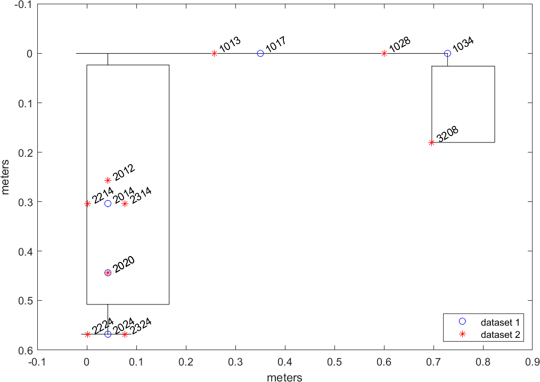
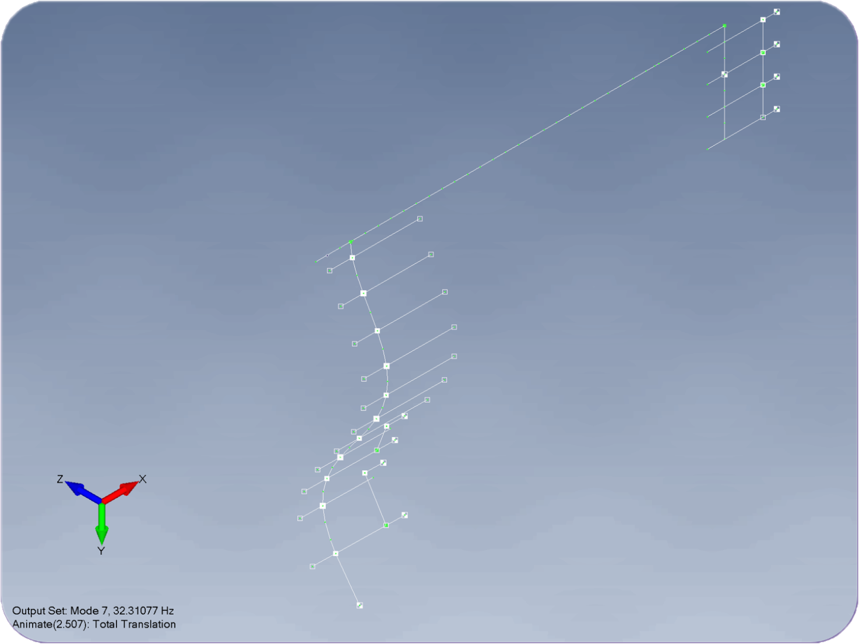
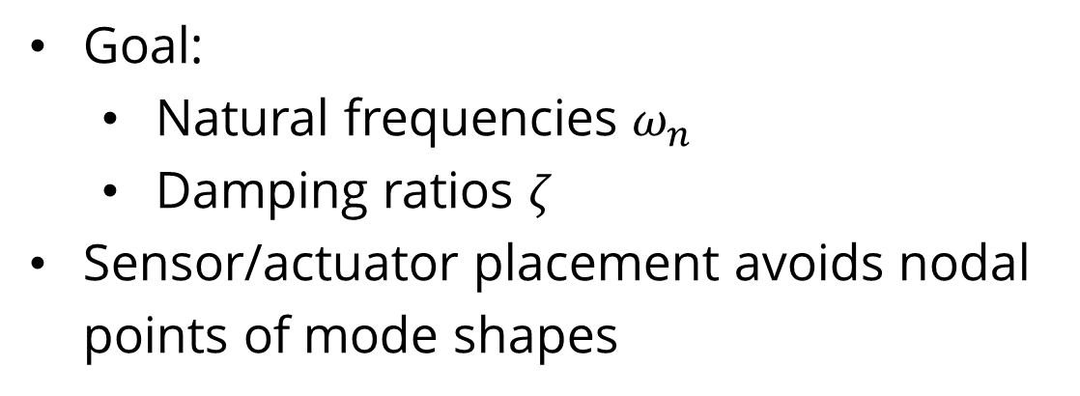
FEM & GVT
GVT
Goal:
Natural frequencies $ω_{n}$
Damping ratios $ζ$
Sensor/actuator placement avoids nodal points of mode shapes
Notes:
sensor and actuator placement avoids nodal points of the mode shapes
bottom right: the mode shape image from the last slide
notice: the “2020” location is directly over the antinodal point of this mode shape
notice: several tested points lie close to a nodal point of this mode shape, so they won’t sense very much motion from it
however, they are well-placed for other mode shapes
enough points were chosen to capture all modes of interest

Slide 12
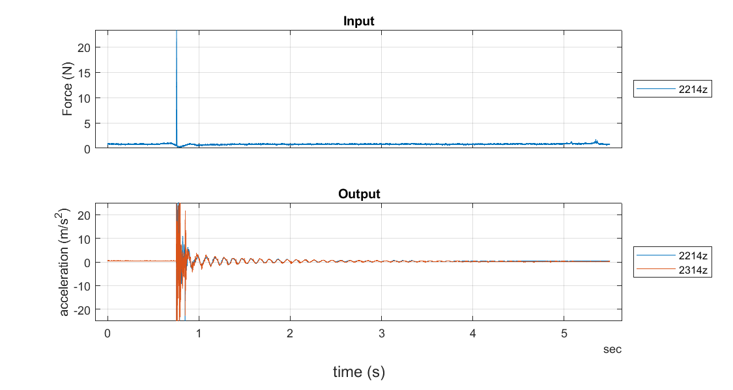
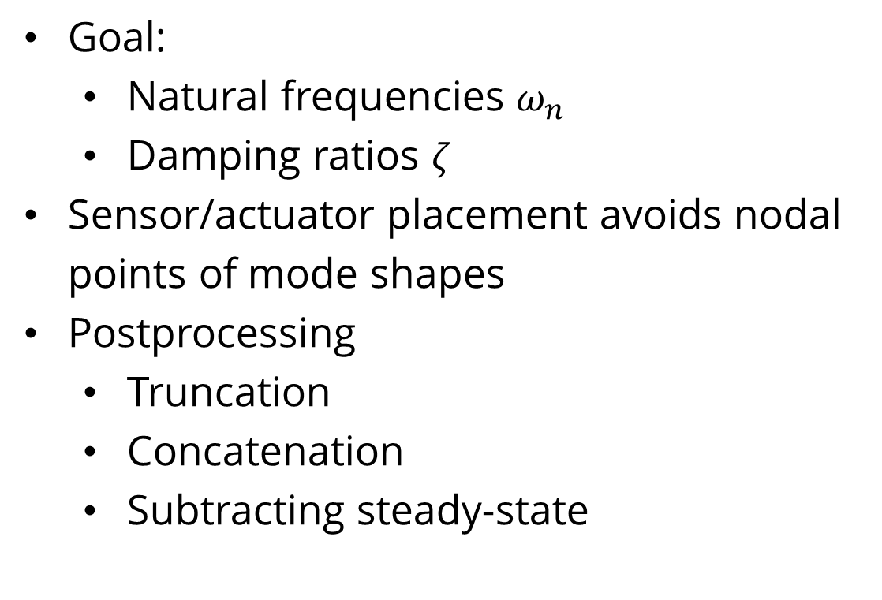
FEM & GVT
GVT
Goal:
Natural frequencies $ω_{n}$
Damping ratios $ζ$
Sensor/actuator placement avoids nodal points of mode shapes
Postprocessing
Truncation
Concatenation
Subtracting steady-state
Notes:
sensor data postprocessing
truncation
get rid of data we don’t need
before impact
after oscillations subside
<point out on chart>
concatenation
combine the 3 runs for a test point into one time history
the chart just shows one run; imagine three of these side by side and you just join them head to tail
although this doesn’t make sense in the time domain, it doesn’t matter as the next step is to transform to the frequency domain where this doesn’t matter
subtract steady-state
this comes from sensor calibration error or drift; it needs to be removed before transforming signals to the frequency domain
<point out on chart>

Slide 13
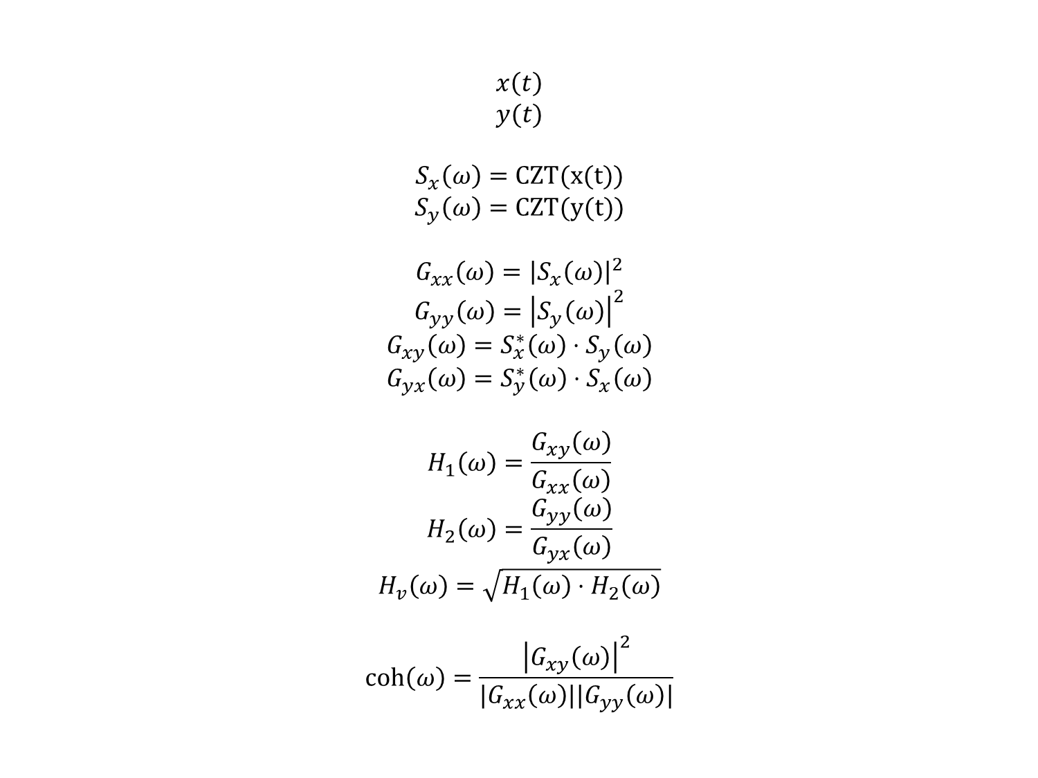
FEM & GVT
GVT
$$x\left(t\right)$$
$$y(t)$$
$$S_{x}\left(ω\right)=\text{CZT}\text{(}\text{x}\text{(}\text{t}\text{))}$$
$$S_{y}\left(ω\right)=\text{CZT}\text{(}\text{y}\text{(}\text{t}\text{))}$$
$$G_{xx}\left(ω\right)={\left|S_{x}\left(ω\right)\right|}^{2}$$
$$G_{yy}\left(ω\right)={\left|S_{y}\left(ω\right)\right|}^{2}$$
$$G_{xy}\left(ω\right)=S_{x}^{∗}\left(ω\right)⋅S_{y}\left(ω\right)$$
$$G_{yx}\left(ω\right)=S_{y}^{∗}\left(ω\right)⋅S_{x}\left(ω\right)$$
$$H_{1}\left(ω\right)=\frac{G_{xy}\left(ω\right)}{G_{xx}\left(ω\right)}$$
$$H_{2}\left(ω\right)=\frac{G_{yy}\left(ω\right)}{G_{yx}\left(ω\right)}$$
$$H_{v}\left(ω\right)=\sqrt{H_{1}\left(ω\right)⋅H_{2}\left(ω\right)}$$
$$\text{coh}\left(ω\right)=\frac{{\left|G_{xy}\left(ω\right)\right|}^{2}}{|G_{xx}\left(ω\right)||G_{yy}\left(ω\right)|}$$
Transform to frequency domain
Chirp Z-transform
Correlation functions
Frequency response function (FRF)
Coherence
Notes:
transform to frequency domain
chirp Z-transform
this is an extension of the fast fourier transform which has some benefits which I will not discuss here
compute correlation functions
Gxx Gyy = autocorrelation functions for the signals
Gxy Gyx = cross-correlation functions for the signals
compute frequency response functions (FRF)
three different ways to do this
H1 FRF
H2 FRF
Hv FRF
these have their pros and cons, but in this study I use the Hv FRF.
coherence

Slide 14
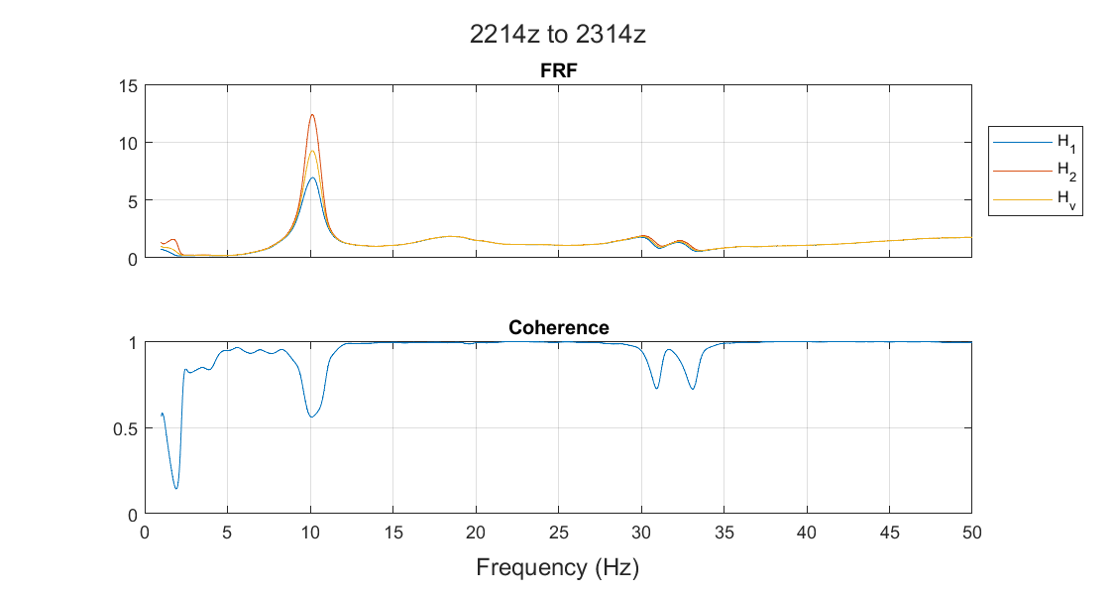
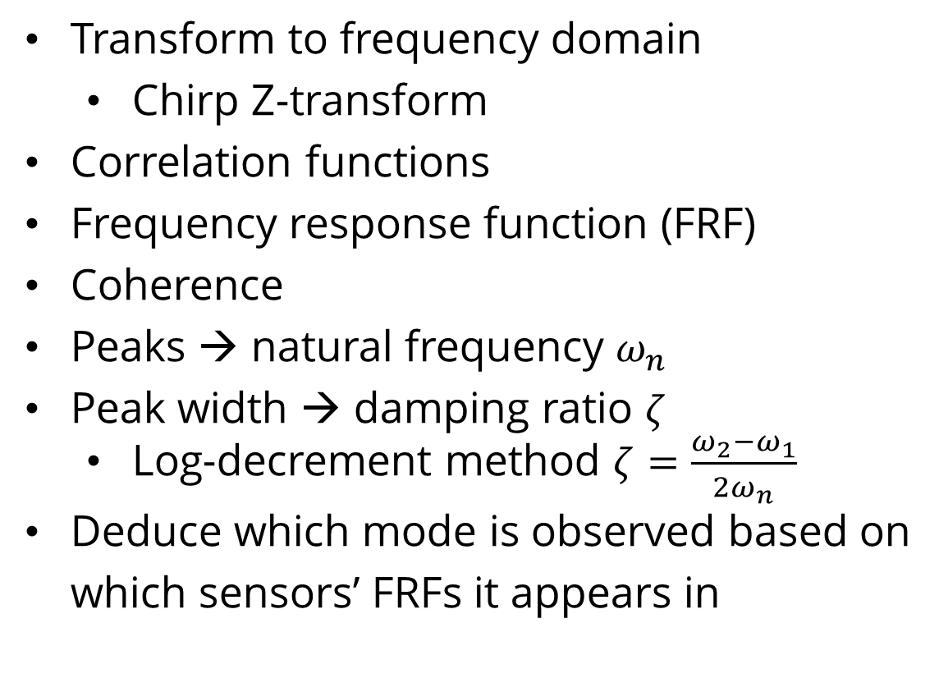
FEM & GVT
GVT
example FRF
Transform to frequency domain
Chirp Z-transform
Correlation functions
Frequency response function (FRF)
Coherence
Peaks → natural frequency $ω_{n}$
Peak width → damping ratio $ζ$
Log-decrement method $ζ=\frac{ω_{2}−ω_{1}}{2ω_{n}}$
Deduce which mode is observed based on which sensors’ FRFs it appears in
Notes:
see left: example FRF magnitude (FRF is complex-valued) and coherence
peaks → natural frequency
<point out on chart>
peak width → damping ratio
wider, shorter peak = more damping
narrower, taller peak = less damping
the log-decrement method (also known as the 3 decibel rule) is used to compute damping from the FRFs
deduce which mode is observed based on which sensors’ FRFs it appears in
go back 3 slides to show example

Slide 15
FEM & GVT
GVT
Adjusted bending and torsional stiffness of FEM elements
Torsional mode is captured
Old | Updated | Experiment | Description
0 | 0 |  | pitching
1.454401 | 1.44397 | 1.422 | wing bending 1
10.51099 | 10.48667 | 10.142 | wing bending 2
 | 19.1997 | 18.094 | wing twisting 1
23.13519 | 21.94804 | 19.893 | fuselage in-plane bending 1
17.81394 | 16.63828 | 19.897 | fuselage bending 1
32.33148 | 32.31077 | 32.545 | wing bending 3
 | - | 51.706 | wing twisting 2
66.02579 | 66.01089 | 60.482 | wing bending 4
69.7988 | 69.29826 |  | wing in-plane bending 1
62.68383 | 60.85218 | 74.521 | fuselage bending 2
Notes:
adjusted bending and torsional stiffness of FEM elements
note: lower frequency modes are more important as they are the primary motions MARGE will see.
especially wing bending 1
torsional mode is captured
<point out on table>

Slide 16
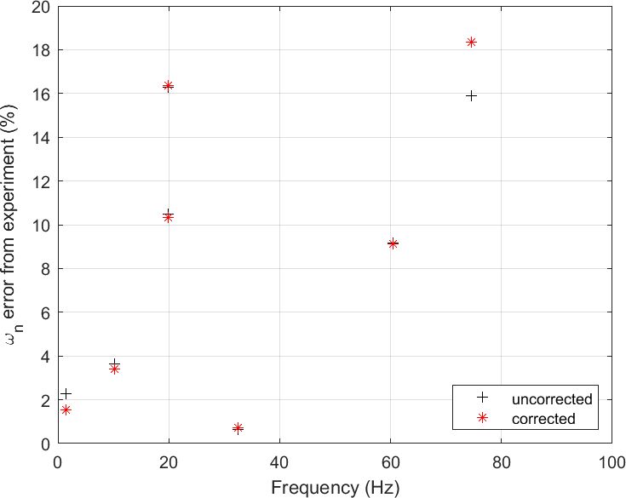
FEM & GVT
GVT
Adjusted bending and torsional stiffness of FEM elements
Torsional mode is captured
FEM matches experiment better
Notes:
FEM matches experiment better
y-axis is the discrepancy between the finite-element model and the experimental result
x-axis the modal frequency
for the key low-frequency modes, the new finite-element model (red) became more accurate than the old model (black)

Slide 17

Mathematical
Model
$$s\vec{x}\left(t\right)=\left[A\right] \vec{x}\left(t\right)+\left[B\right] \vec{u}\left(t\right)$$
$$\vec{y}\left(t\right)=\left[C\right] \vec{x}\left(t\right)+\left[D\right] \vec{u}(t)$$
Notes:
TIME TARGET: 15 MINTUES
Mathematical Modeling
Recall, the goal of this thesis is to obtain a state-space model in the form x rate equals [A]x +[B]u and y equals [C]x+[D]u
It’s now time to dive into the theoretical modeling methods to make this happen

Slide 18
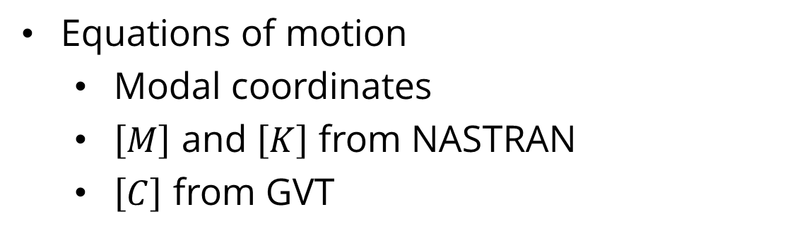
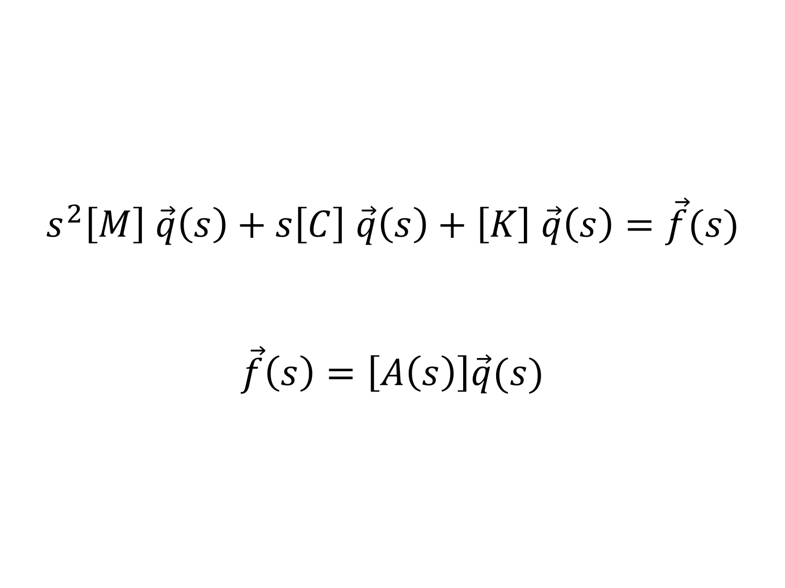
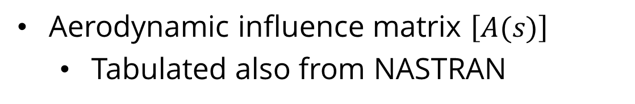
Math Model
Structural Dynamics
$$s^{2}\left[M\right] \vec{q}\left(s\right)+s\left[C\right] \vec{q}\left(s\right)+\left[K\right] \vec{q}\left(s\right)=\vec{f}(s)$$
$$\vec{f}\left(s\right)=\left[A\left(s\right)\right]\vec{q}(s)$$
Equations of motion
Modal coordinates
$\left[M\right]$ and $\left[K\right]$ from NASTRAN
$\left[C\right]$ from GVT
Aerodynamics
Aerodynamic influence matrix $\left[A(s)\right]$
Tabulated also from NASTRAN
Notes:
Structural Dynamics
start with the structural dynamic equations of motion expressed in the Laplace domain
it’s a second-order equation
q is the structural dynamic state in modal coordinates
(as mentioned earlier, decomposing any motion of the system into a combination of the modes)
mass and stiffness matrices [M] and [K] are obtained from the NASTRAN finite-element model
the viscous damping matrix [C] is a diagonal matrix with the damping ratios obtained from GVT
Aerodynamics
ok, we have the structural dyamic equation. what is the forcing F on the right side?
the aerodynamic forcing!
this forcing takes the form of a “aerodynamic influence” matrix [A] multiplying the state
since, of course, the force on the wing depends on the shape of the wing
remember the doublet-lattice aerodynamic model from NASTRAN?
we have tabulated aerodynamic forcing [A] from there at various frequencies
however, this is not a neat matrix that we can turn into the state-space model we want in the end

Slide 19
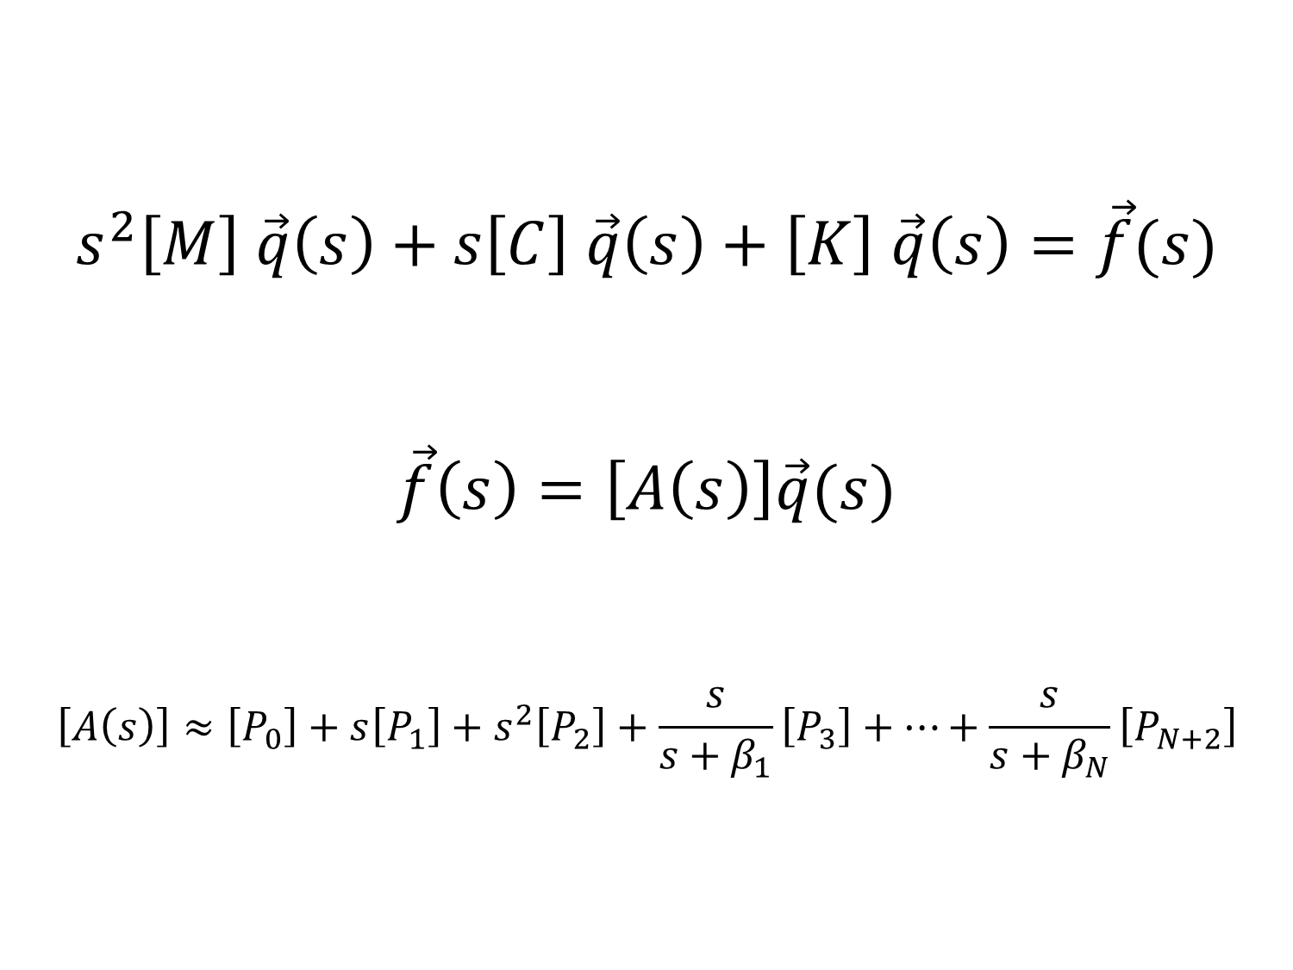
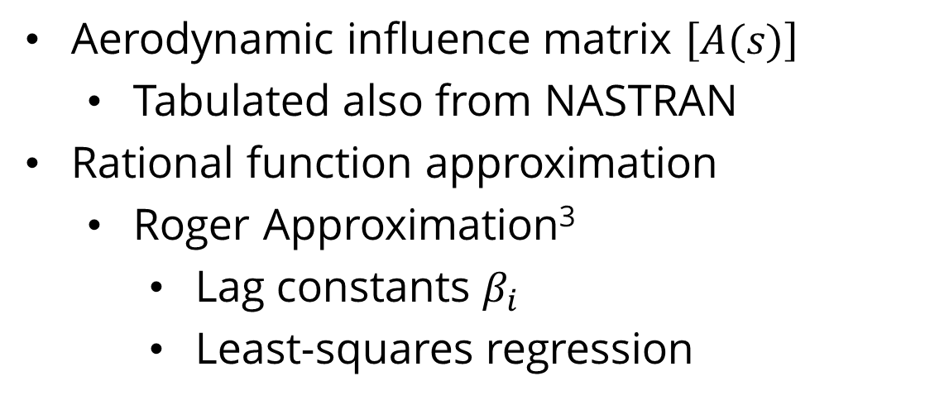
Math Model
Structural Dynamics
$$s^{2}\left[M\right] \vec{q}\left(s\right)+s\left[C\right] \vec{q}\left(s\right)+\left[K\right] \vec{q}\left(s\right)=\vec{f}(s)$$
$$\vec{f}\left(s\right)=\left[A\left(s\right)\right]\vec{q}(s)$$
$$\left[A\left(s\right)\right]≈\left[P_{0}\right]+s\left[P_{1}\right]+s^{2}\left[P_{2}\right]+\frac{s}{s+β_{1}}\left[P_{3}\right]+…+\frac{s}{s+β_{N}}\left[P_{N+2}\right]$$
Equations of motion
Modal coordinates
$\left[M\right]$ and $\left[K\right]$ from NASTRAN
$\left[C\right]$ from GVT
Aerodynamics
Aerodynamic influence matrix $\left[A(s)\right]$
Tabulated also from NASTRAN
Rational function approximation
Roger Approximation³
Lag constants $β_{i}$
Least-squares regression
Notes:
Roger approximation
so, turn to a rational function approximation
The Roger approximation is a way to approximate a table of aerodynamic influence matrices [A]
it has these 0th, first and second order terms
and it accounts for temporal lag effects with these lag terms
the [P] matrices are what are set to make this fit the [A] matrices
this is done with a least-squares regression

Slide 20
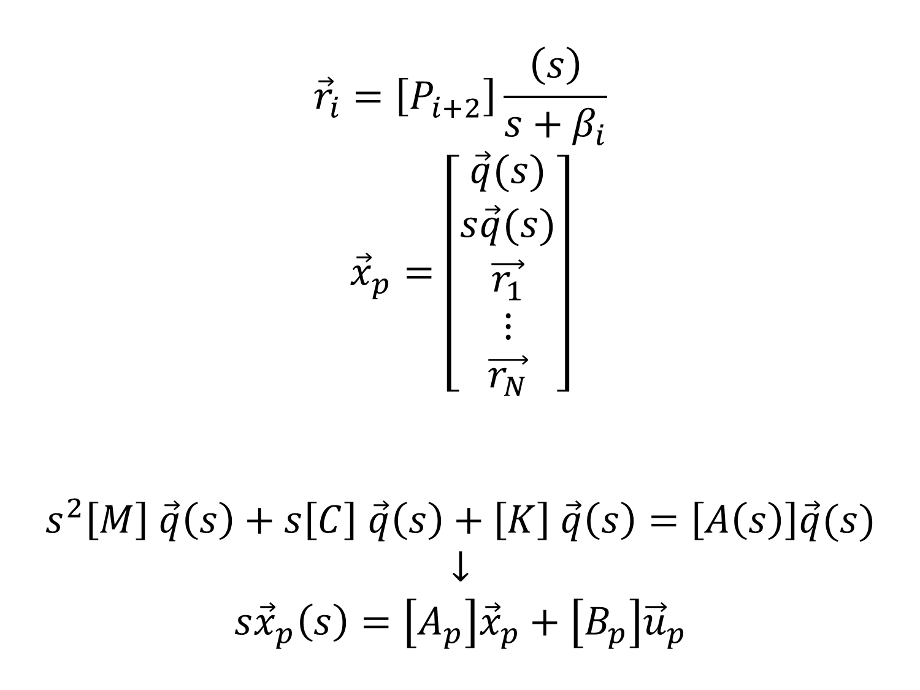
Math Model
Plant Dynamics
$${\vec{r}}_{i}=\left[P_{i+2}\right]\frac{\left(s\right)}{s+β_{i}}$$
$${\vec{x}}_{p}=\left[\begin{aligned}\vec{q}(s) \\ s\vec{q}(s) \\ \vec{r_{1}} \\ ⋮ \\ \vec{r_{N}}\end{aligned}\right]$$
$$s^{2}\left[M\right] \vec{q}\left(s\right)+s\left[C\right] \vec{q}\left(s\right)+\left[K\right] \vec{q}\left(s\right)=\left[A\left(s\right)\right]\vec{q}(s)$$
$$↓$$
$$s{\vec{x}}_{p}\left(s\right)=\left[A_{p}\right]{\vec{x}}_{p}+\left[B_{p}\right]{\vec{u}}_{p}$$
State vector
position
velocity
lag terms
Reduce order of equations of motion to first-order → state-space model
Notes:
plant dynamics
state vector
modal position
modal velocity
lag terms to track those lag effects
won’t go through how those are defined here
by tracking the model velocities and the lag terms, we can reduce order of the equations of motion to first order
and after tons of rearranging terms the first order equation comes out to the desired form, x rate = [A]x+[B]u

Slide 21
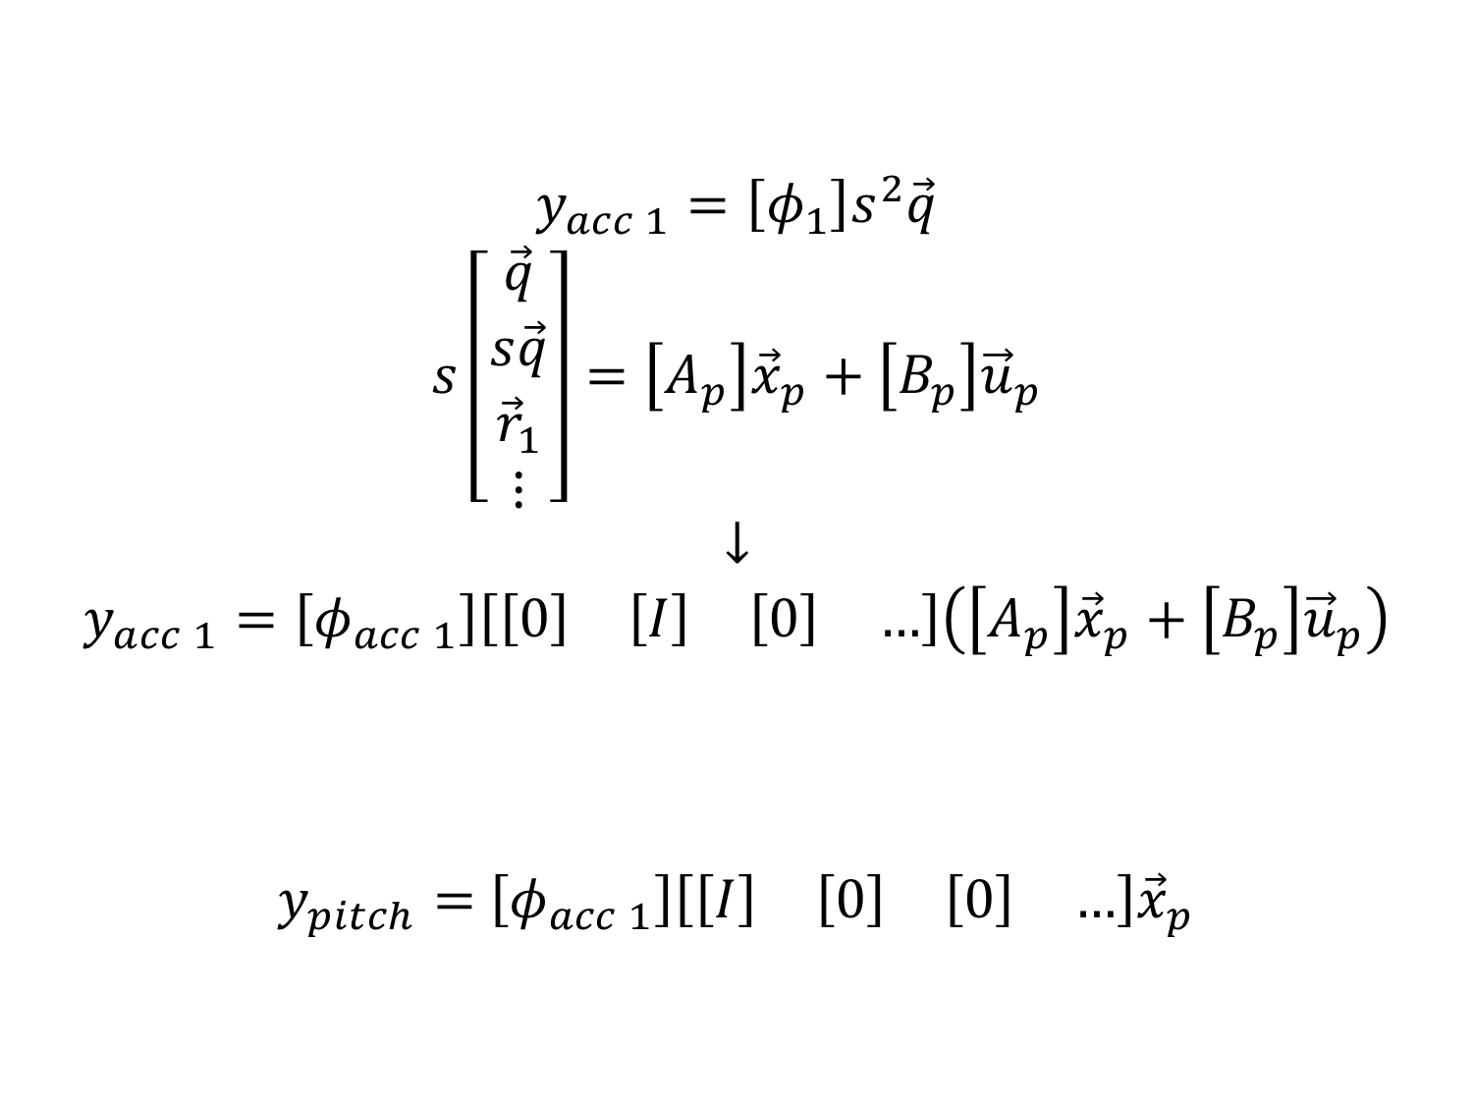
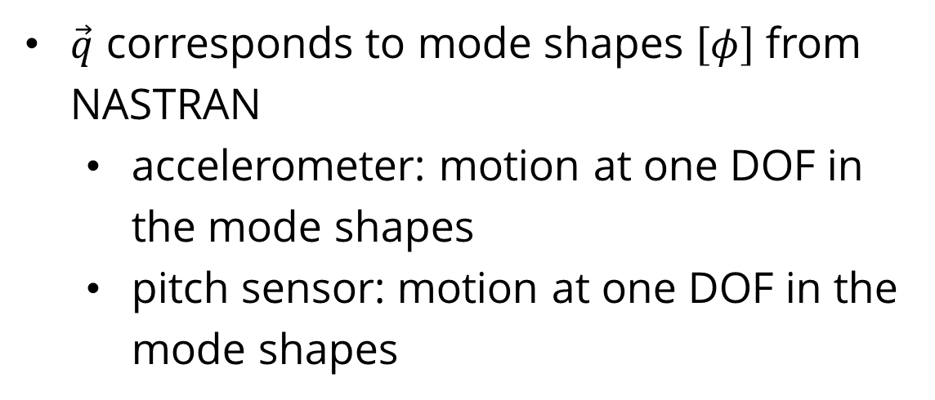
Math Model
Plant Output
$$y_{acc 1}=\left[φ_{1}\right]s^{2}\vec{q}$$
$$s\left[\begin{aligned}\vec{q} \\ s\vec{q} \\ {\vec{r}}_{1} \\ ⋮\end{aligned}\right]=\left[A_{p}\right]{\vec{x}}_{p}+\left[B_{p}\right]{\vec{u}}_{p}$$
$$↓$$
$$y_{acc 1}=\left[φ_{acc 1}\right]\left[\begin{matrix}\left[0\right] & \left[I\right] & \left[0\right] & …\end{matrix}\right]\left(\left[A_{p}\right]{\vec{x}}_{p}+\left[B_{p}\right]{\vec{u}}_{p}\right)$$
$y_{pitch}=$ $\left[φ_{acc 1}\right]\left[\begin{matrix}\left[I\right] & \left[0\right] & \left[0\right] & …\end{matrix}\right]{\vec{x}}_{p}$
$\vec{q}$ corresponds to mode shapes $\left[φ\right]$ from NASTRAN
accelerometer: motion at one DOF in the mode shapes
pitch sensor: motion at one DOF in the mode shapes
Notes:
plant output
what about the second half of the state-space model y=[B]x+[C]u?
let’s talk about it
each mode has a mode shape (lets call PHI) which we can get from NASTRAN
given the modal state vector q, we can obtain the physical shape of MARGE at any point (in the NASTRAN model)
the pitch for the pitch sensor can be taken as one of these
the accelerometer requires the acceleration, not the position
but we have an equation for the modal acceleration that we derived on the previous slide!
(since velocity is in the state vector and we have the equation for the state rate)
and the acceleration for the accelerometers can be modeled in this way

Slide 22
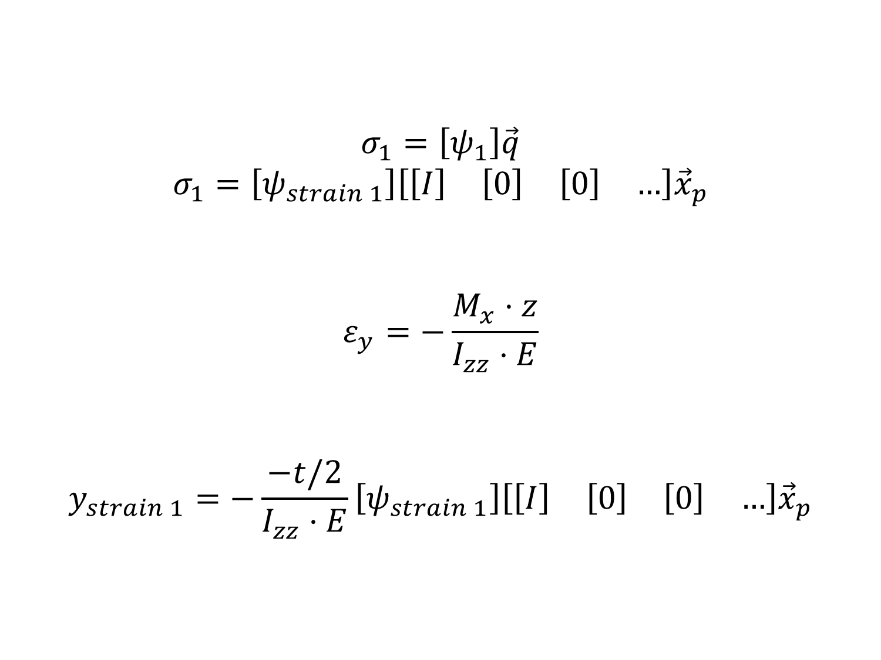
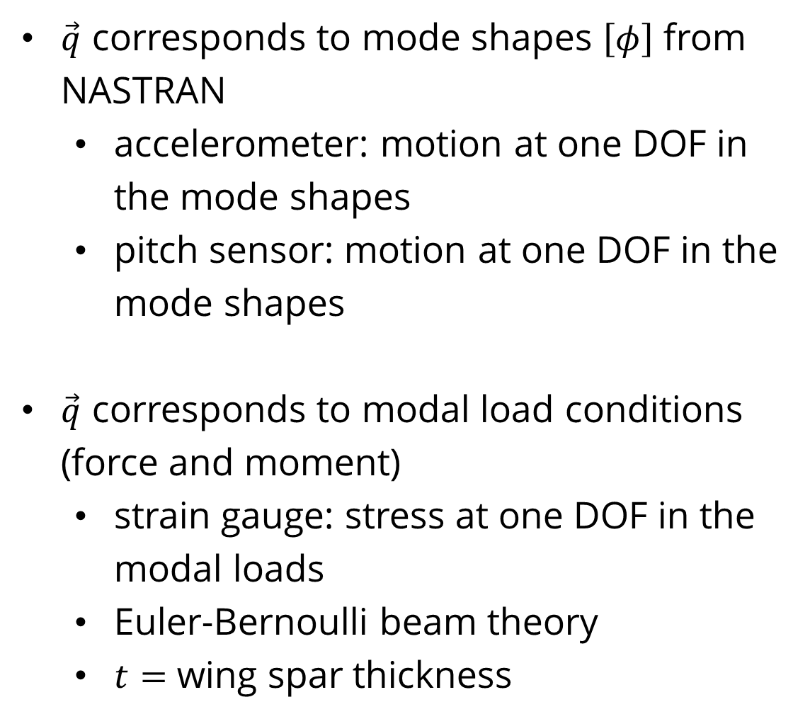
Math Model
Plant Output
$$σ_{1}=\left[ψ_{1}\right]\vec{q}$$
$$σ_{1}=\left[ψ_{strain 1}\right]\left[\begin{matrix}\left[I\right] & \left[0\right] & \left[0\right] & …\end{matrix}\right]{\vec{x}}_{p}$$
$$ε_{y}=−\frac{M_{x}⋅z}{I_{zz}⋅E}$$
$$y_{strain 1}=−\frac{−t/2}{I_{zz}⋅E}\left[ψ_{strain 1}\right]\left[\begin{matrix}\left[I\right] & \left[0\right] & \left[0\right] & …\end{matrix}\right]{\vec{x}}_{p}$$
$\vec{q}$ corresponds to mode shapes $\left[φ\right]$ from NASTRAN
accelerometer: motion at one DOF in the mode shapes
pitch sensor: motion at one DOF in the mode shapes
$\vec{q}$ corresponds to modal load conditions (force and moment)
strain gauge: stress at one DOF in the modal loads
Euler-Bernoulli beam theory
$t=$ wing spar thickness
Notes:
the modal state q also corresponds to the forces and moments for each mode
the force at the wing root can be determined
the strain can be computed using this relation from Euler-Bernoulli beam theory,
where t is the beam (wing spar) thickness
strain for the strain gauge output can be thus be modeled in this way
also as a linear function of the state vector {x}

Slide 23
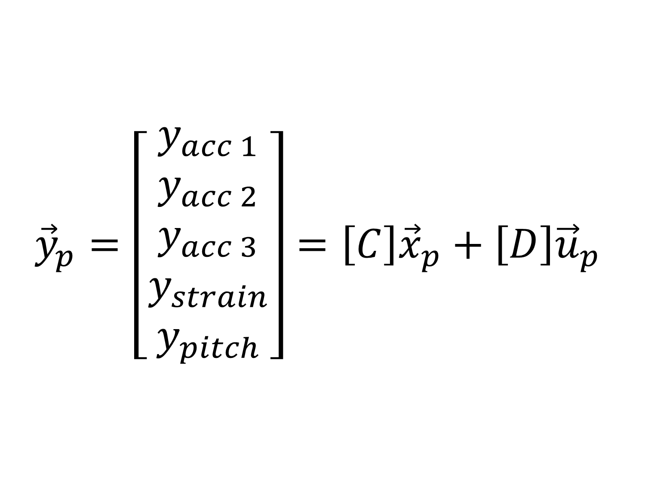
Math Model
Plant Output
$${\vec{y}}_{p}=\left[\begin{aligned}y_{acc 1} \\ y_{acc 2} \\ y_{acc 3} \\ y_{strain} \\ y_{pitch}\end{aligned}\right]=\left[C\right]{\vec{x}}_{p}+\left[D\right]{\vec{u}}_{p}$$
$\vec{q}$ corresponds to mode shapes $\left[φ\right]$ from NASTRAN
accelerometer: motion at one DOF in the mode shapes
pitch sensor: motion at one DOF in the mode shapes
$\vec{q}$ corresponds to modal load conditions (force and moment)
strain gauge: stress at one DOF in the modal loads
Euler-Bernoulli beam theory
$t=$ wing spar thickness
Notes:
and if we combine all of these (x3 for the acclelerometers) into big matrices which I call [C] and [D], we get the y=[C]x+[D]u we wanted
but why am I calling the state vector and the input vector xp and up so far? …
<next slide>

Slide 24
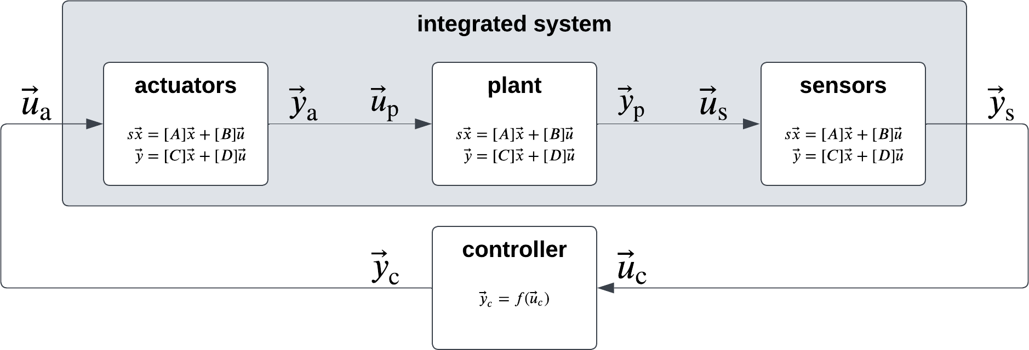
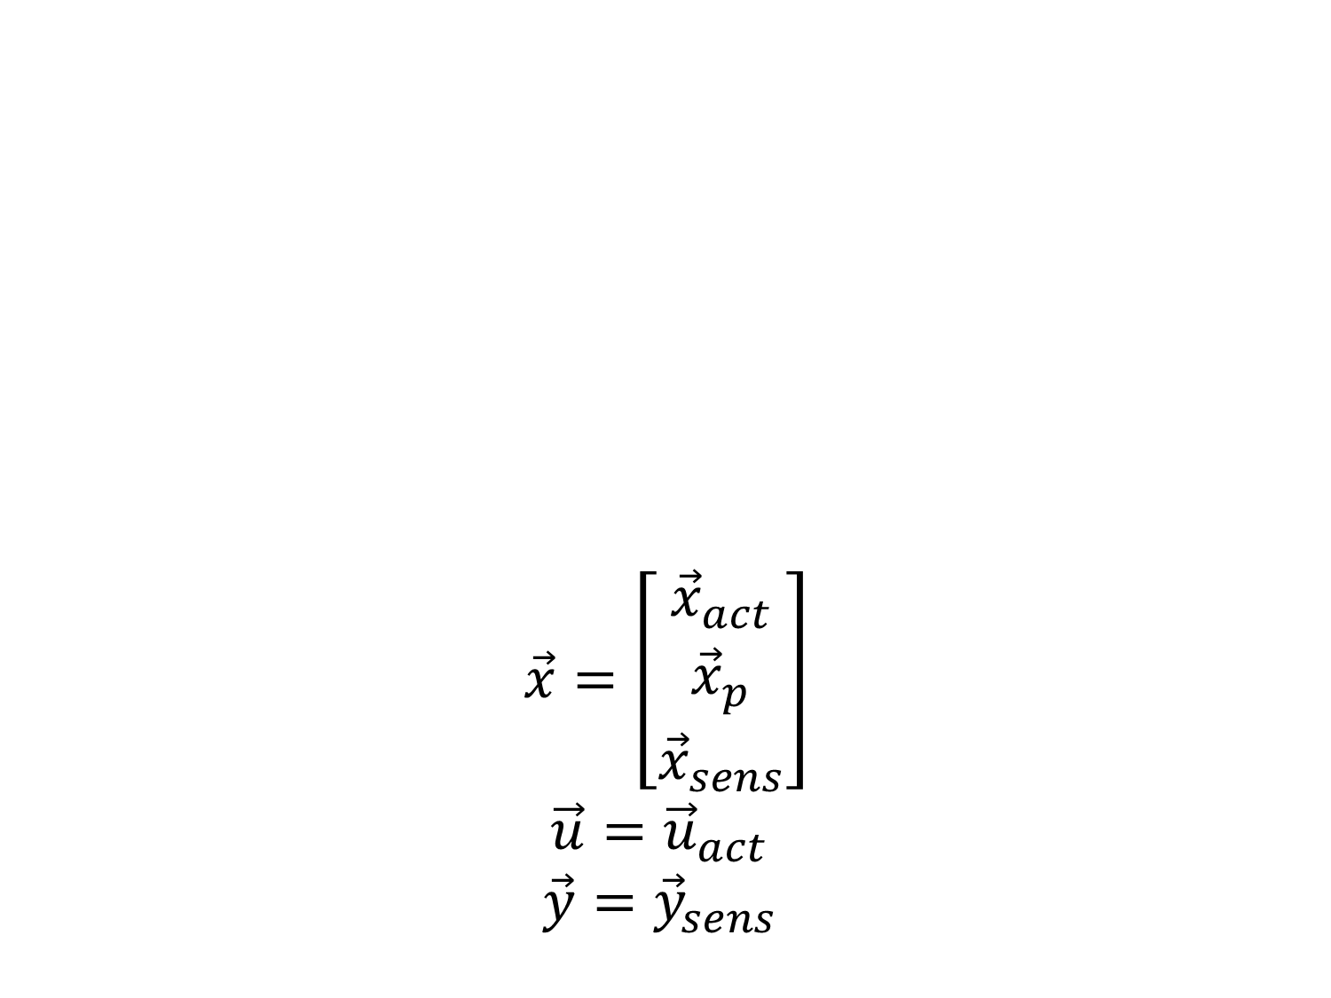
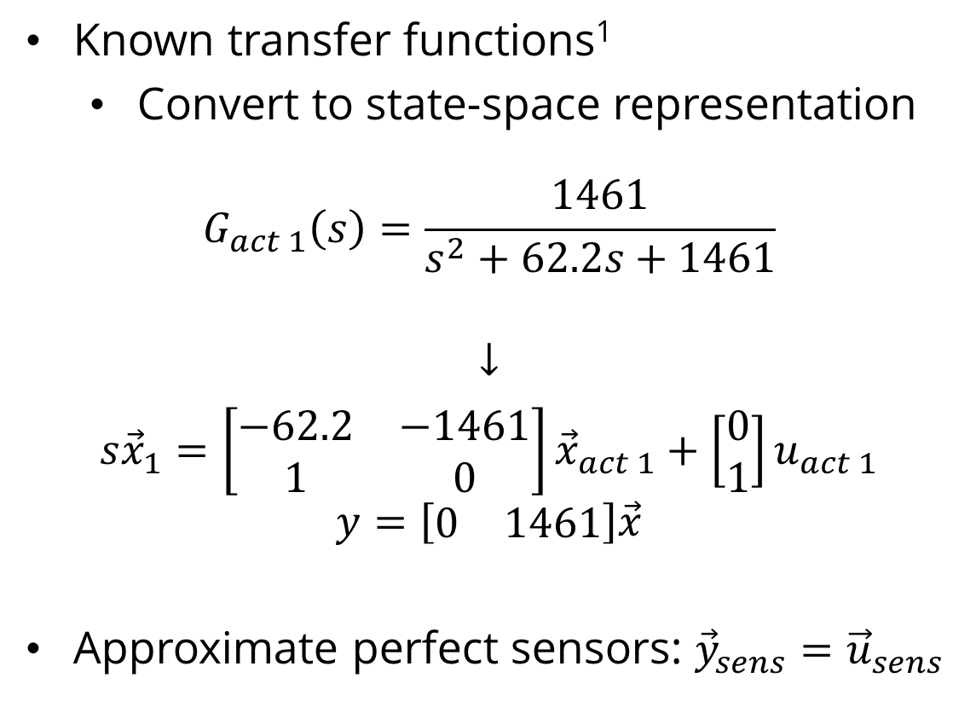
Math Model
Actuators & Sensors
$$\vec{x}=\left[\begin{aligned}{\vec{x}}_{act} \\ {\vec{x}}_{p} \\ {\vec{x}}_{sens}\end{aligned}\right]$$
$$\vec{u}={\vec{u}}_{act}$$
$$\vec{y}={\vec{y}}_{sens}$$
Known transfer functions¹
Convert to state-space representation
$$G_{act 1}\left(s\right)=\frac{1461}{s^{2}+62.2s+1461}$$
$$↓$$
$$s{\vec{x}}_{1}=\left[\begin{matrix}−62.2 & −1461 \\ 1 & 0\end{matrix}\right]{\vec{x}}_{act 1}+\left[\begin{aligned}0 \\ 1\end{aligned}\right]u_{act 1}$$
$$y=\left[\begin{matrix}0 & 1461\end{matrix}\right]\vec{x}$$
Approximate perfect sensors: ${\vec{y}}_{sens}={\vec{u}}_{sens}$
Coupled Aeroservoelastics
Chain together state-space models
Notes:
actuators and sensors
have their own dynamics! (p stands for plant)
these have to be accounted for in our model or the lag in the actuators and sensors will become (unintended) lag in the model
the actuators have known transfer functions from testing in years past
can convert them to state-space representation as shown
and then the output y of the sensors becomes the input u of the plant
the output y of the plant becomes the input u of the sensors
but for MARGE the sensors are very responsive so they can be approximated as perfect
coupled Aeroservoelastics
chain together state-space models
get one large coupled state-space model which looks like <next slide>

Slide 25
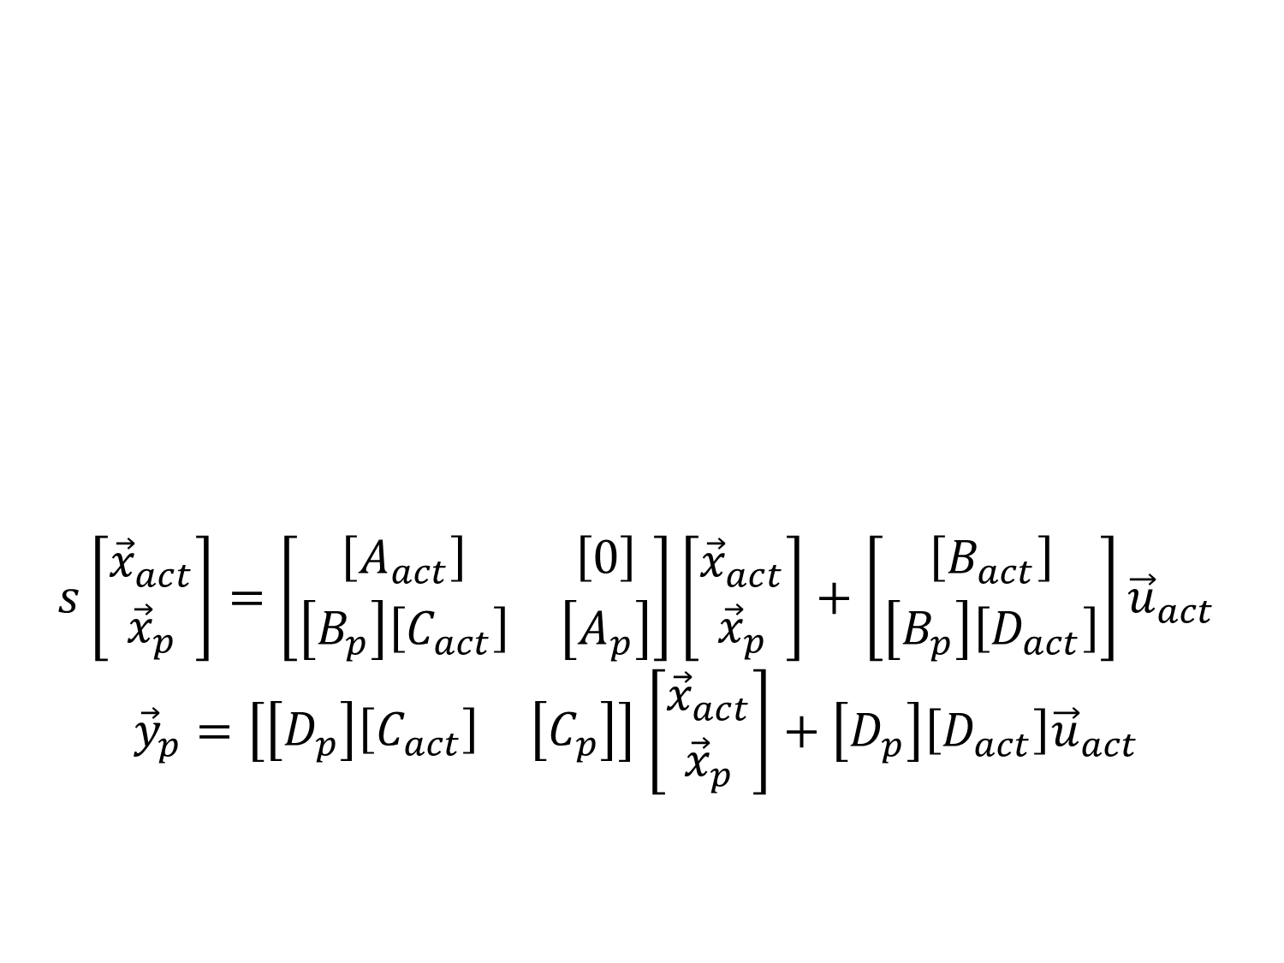
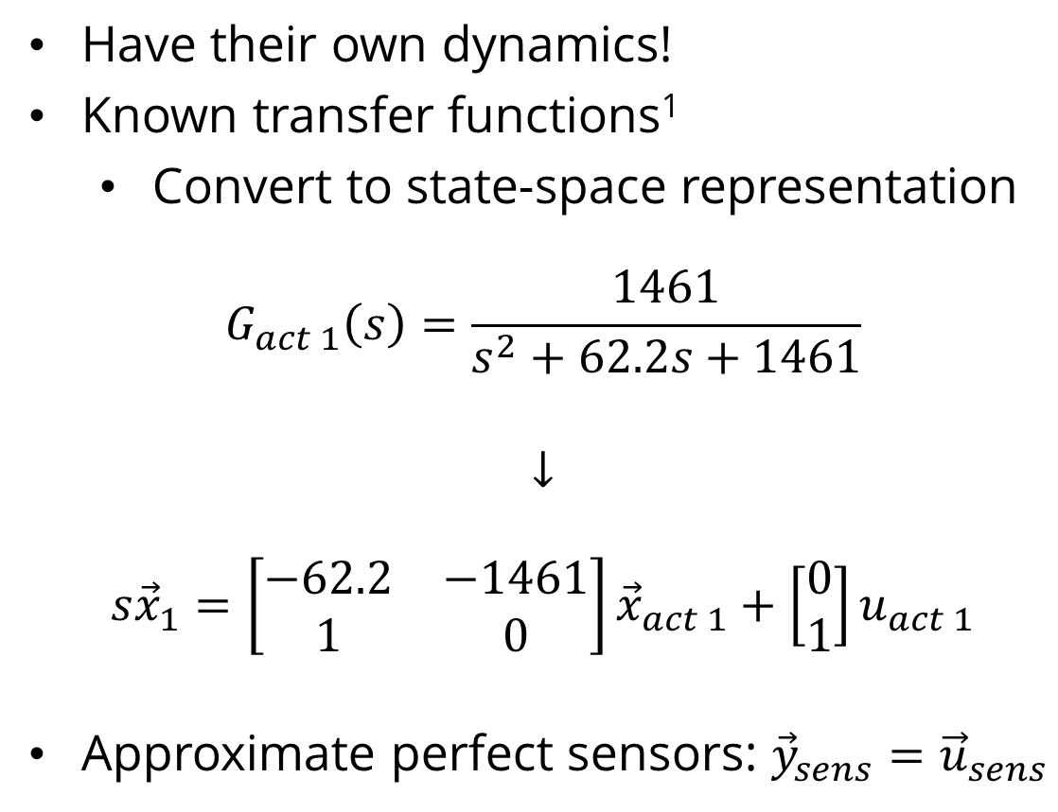
Math Model
Actuators & Sensors
$$s\left[\begin{aligned}{\vec{x}}_{act} \\ {\vec{x}}_{p}\end{aligned}\right]=\left[\begin{matrix}\left[A_{act}\right] & \left[0\right] \\ \left[B_{p}\right]\left[C_{act}\right] & \left[A_{p}\right]\end{matrix}\right]\left[\begin{aligned}{\vec{x}}_{act} \\ {\vec{x}}_{p}\end{aligned}\right]+\left[\begin{aligned}\left[B_{act}\right] \\ \left[B_{p}\right]\left[D_{act}\right]\end{aligned}\right]{\vec{u}}_{act}$$
${\vec{y}}_{p}=\left[\begin{matrix}\left[D_{p}\right]\left[C_{act}\right] & \left[C_{p}\right]\end{matrix}\right]$ $\left[\begin{aligned}{\vec{x}}_{act} \\ {\vec{x}}_{p}\end{aligned}\right]+\left[D_{p}\right]\left[D_{act}\right]{\vec{u}}_{act}$
Have their own dynamics!
Known transfer functions¹
Convert to state-space representation
$$G_{act 1}\left(s\right)=\frac{1461}{s^{2}+62.2s+1461}$$
$$↓$$
$$s{\vec{x}}_{1}=\left[\begin{matrix}−62.2 & −1461 \\ 1 & 0\end{matrix}\right]{\vec{x}}_{act 1}+\left[\begin{aligned}0 \\ 1\end{aligned}\right]u_{act 1}$$
Approximate perfect sensors: ${\vec{y}}_{sens}={\vec{u}}_{sens}$
Coupled Aeroservoelastics
Chain together state-space models
Notes:
(of course, not showing all the entries in each of these submatrices)
this is our fully derived state-space model!

Slide 26
Wind Tunnel Testing
Why?
Validate mathematical model
Update mathematical model
Notes:
TIME TARGET: 25 MINTUES
Wind Tunnel Testing
Why?
Validate mathematical model (find how well it works)
Update mathematical model (make it work better)

Slide 27
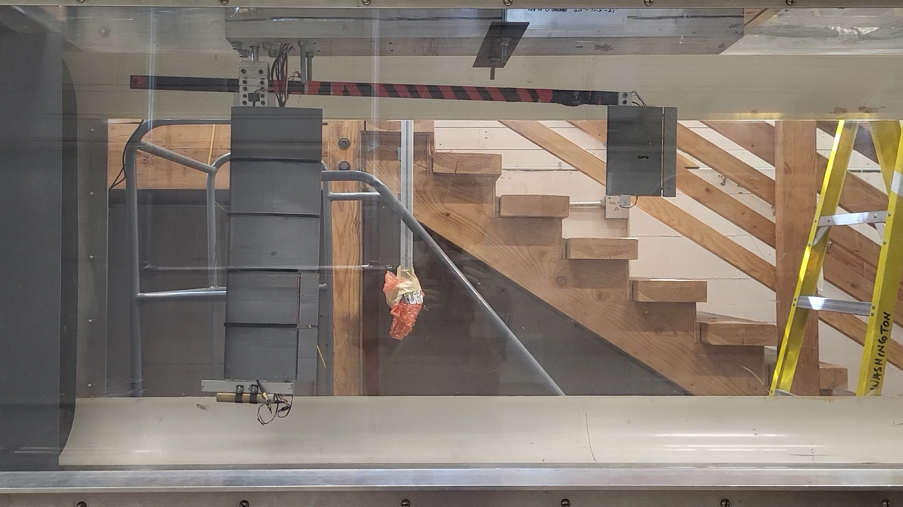
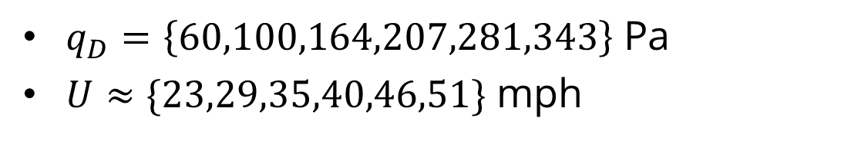
Wind Tunnel
Test Interface
Simulink Real-Time
National Instruments DAQ
Test Conditions
$q_{D}=\left\{60,100,164,207,281,343\right\}$ Pa
$U≈\{23,29,35,40,46,51\}$ mph
Test Plan
On-board control: frequency sweep
Gust vanes: doublet
Three runs for each input for each speed
Notes:
Here is MARGE mounted in the 3x3 wind tunnel just outside
suspended from ceiling
test interface
the actuators were controlled using Simulink
the sensor data was read using a National Instruments data acquisition system
and pulled into Simulink in real-time
test conditions
MARGE was tested at these six airspeeds
test plan
for the ailerons and elevators, frequency sweeps were performed at each speed
for the gust vanes, the doublet response was recorded at each speed
there were three runs for each of these (like in the GVT)

Slide 28
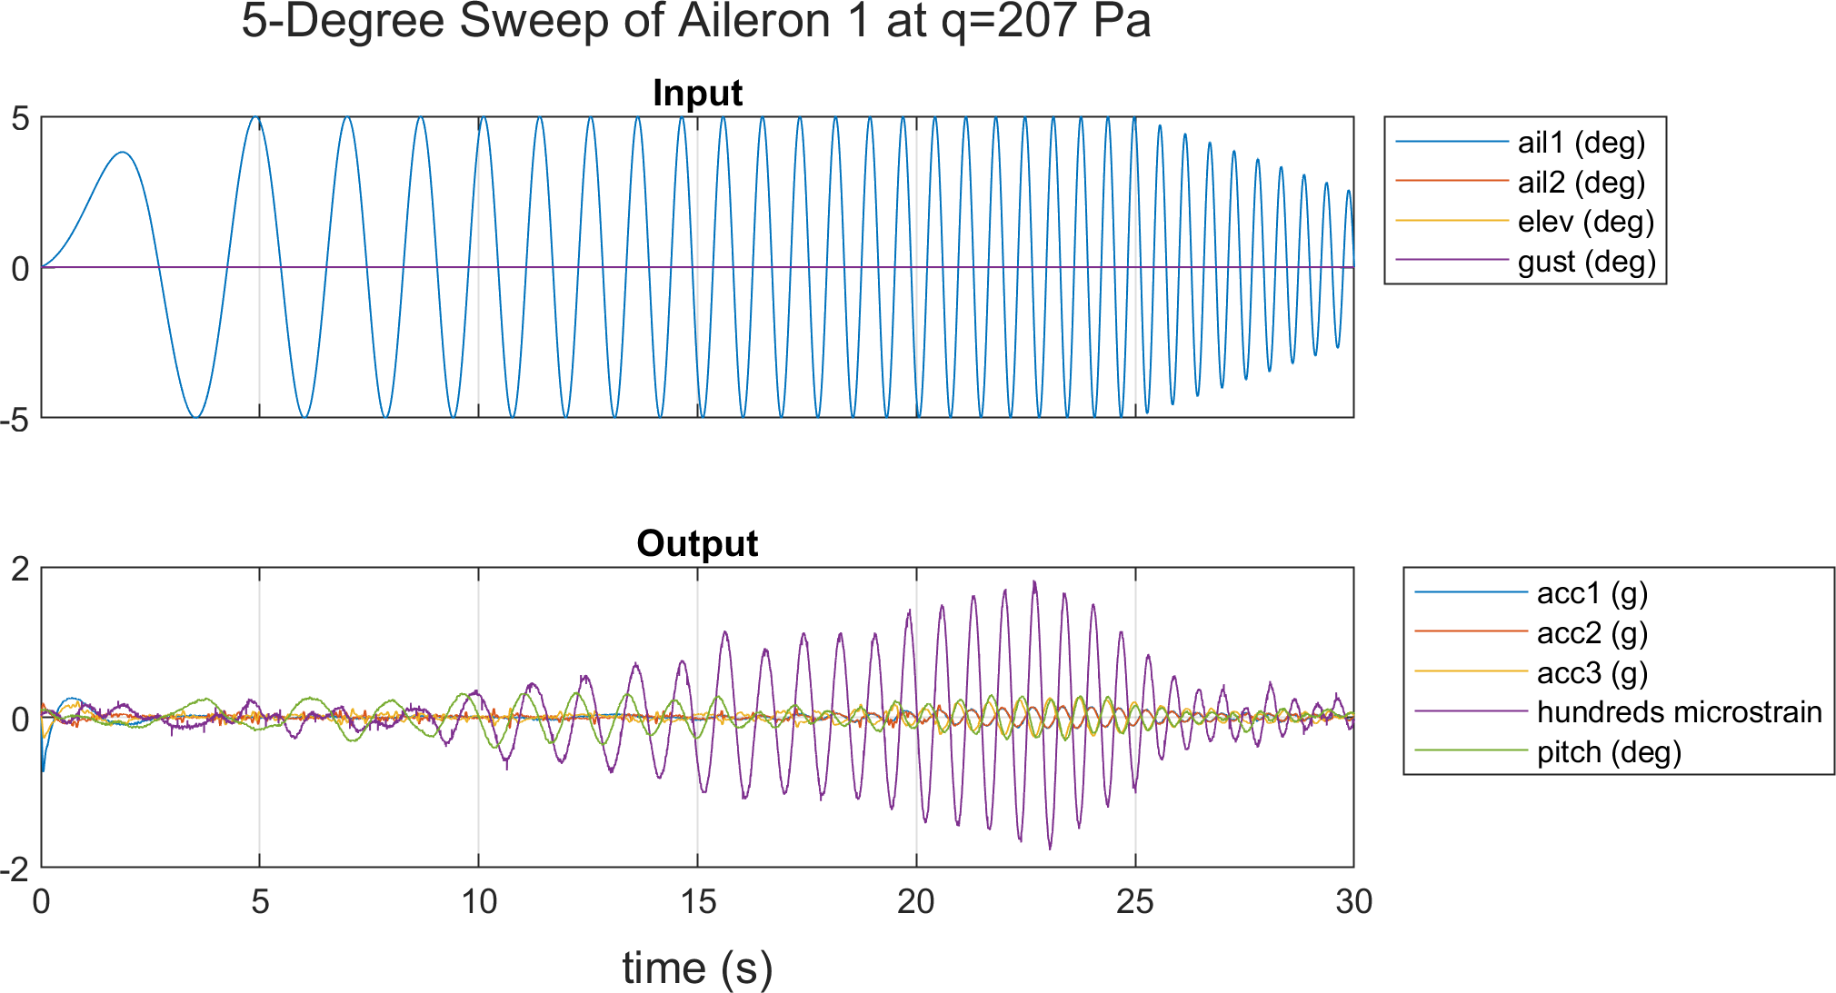
Wind Tunnel
Postprocessing
Truncation
Concatenation
Subtracting steady-state
Filtering
Bandpass filter
Transform to frequency domain
Correlation functions
Frequency response function (FRF)
Notes:
postprocessing
pretty much the same as the GVT
truncation
concatenation
subtract steady-state component
filtering of accelerometer data with a bandpass filter (not same as GVT)
this was necessary to eliminate sensor drift and electrical interference in the accelerometers
transform to frequency domain
compute correlation functions
compute FRFs
see left: example experimental time-series data

Slide 29
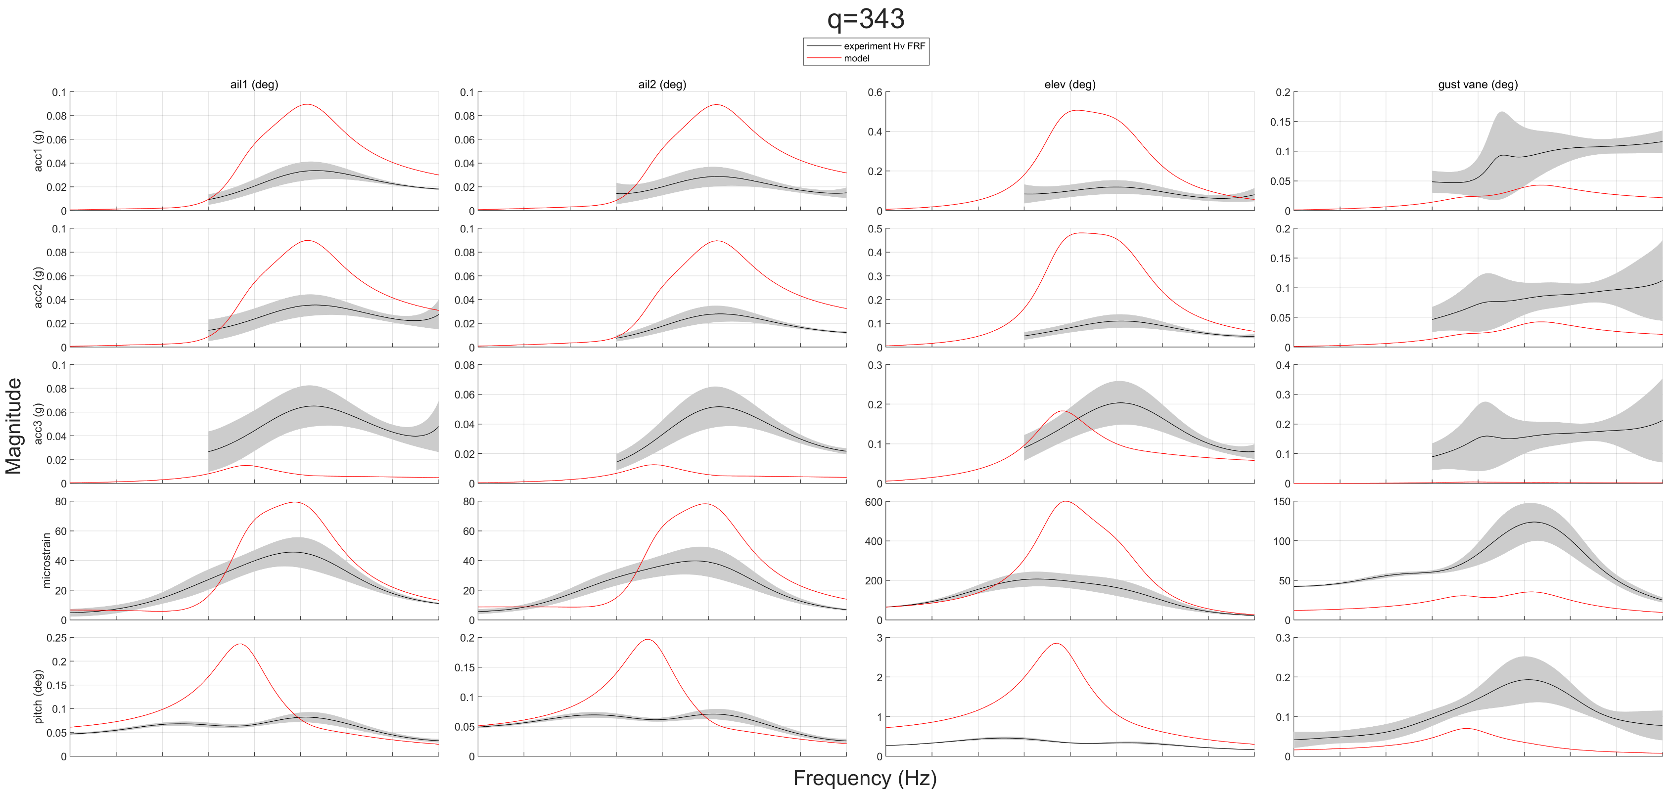
Wind Tunnel
Notes:
Here is the frequency response for each sensor from each actuator’s input
black = experiment
red = the state-space model
the fit is bad. but this is not the end…

Slide 30
Model Tuning
Why?
Simple model does not yet match messy reality
Notes:
TIME TARGET: 30 MINTUES
Model tuning
Why?
Simple model does not yet match messy reality
The model should be adjusted to better reflect reality (which is the whole point of the model)

Slide 31
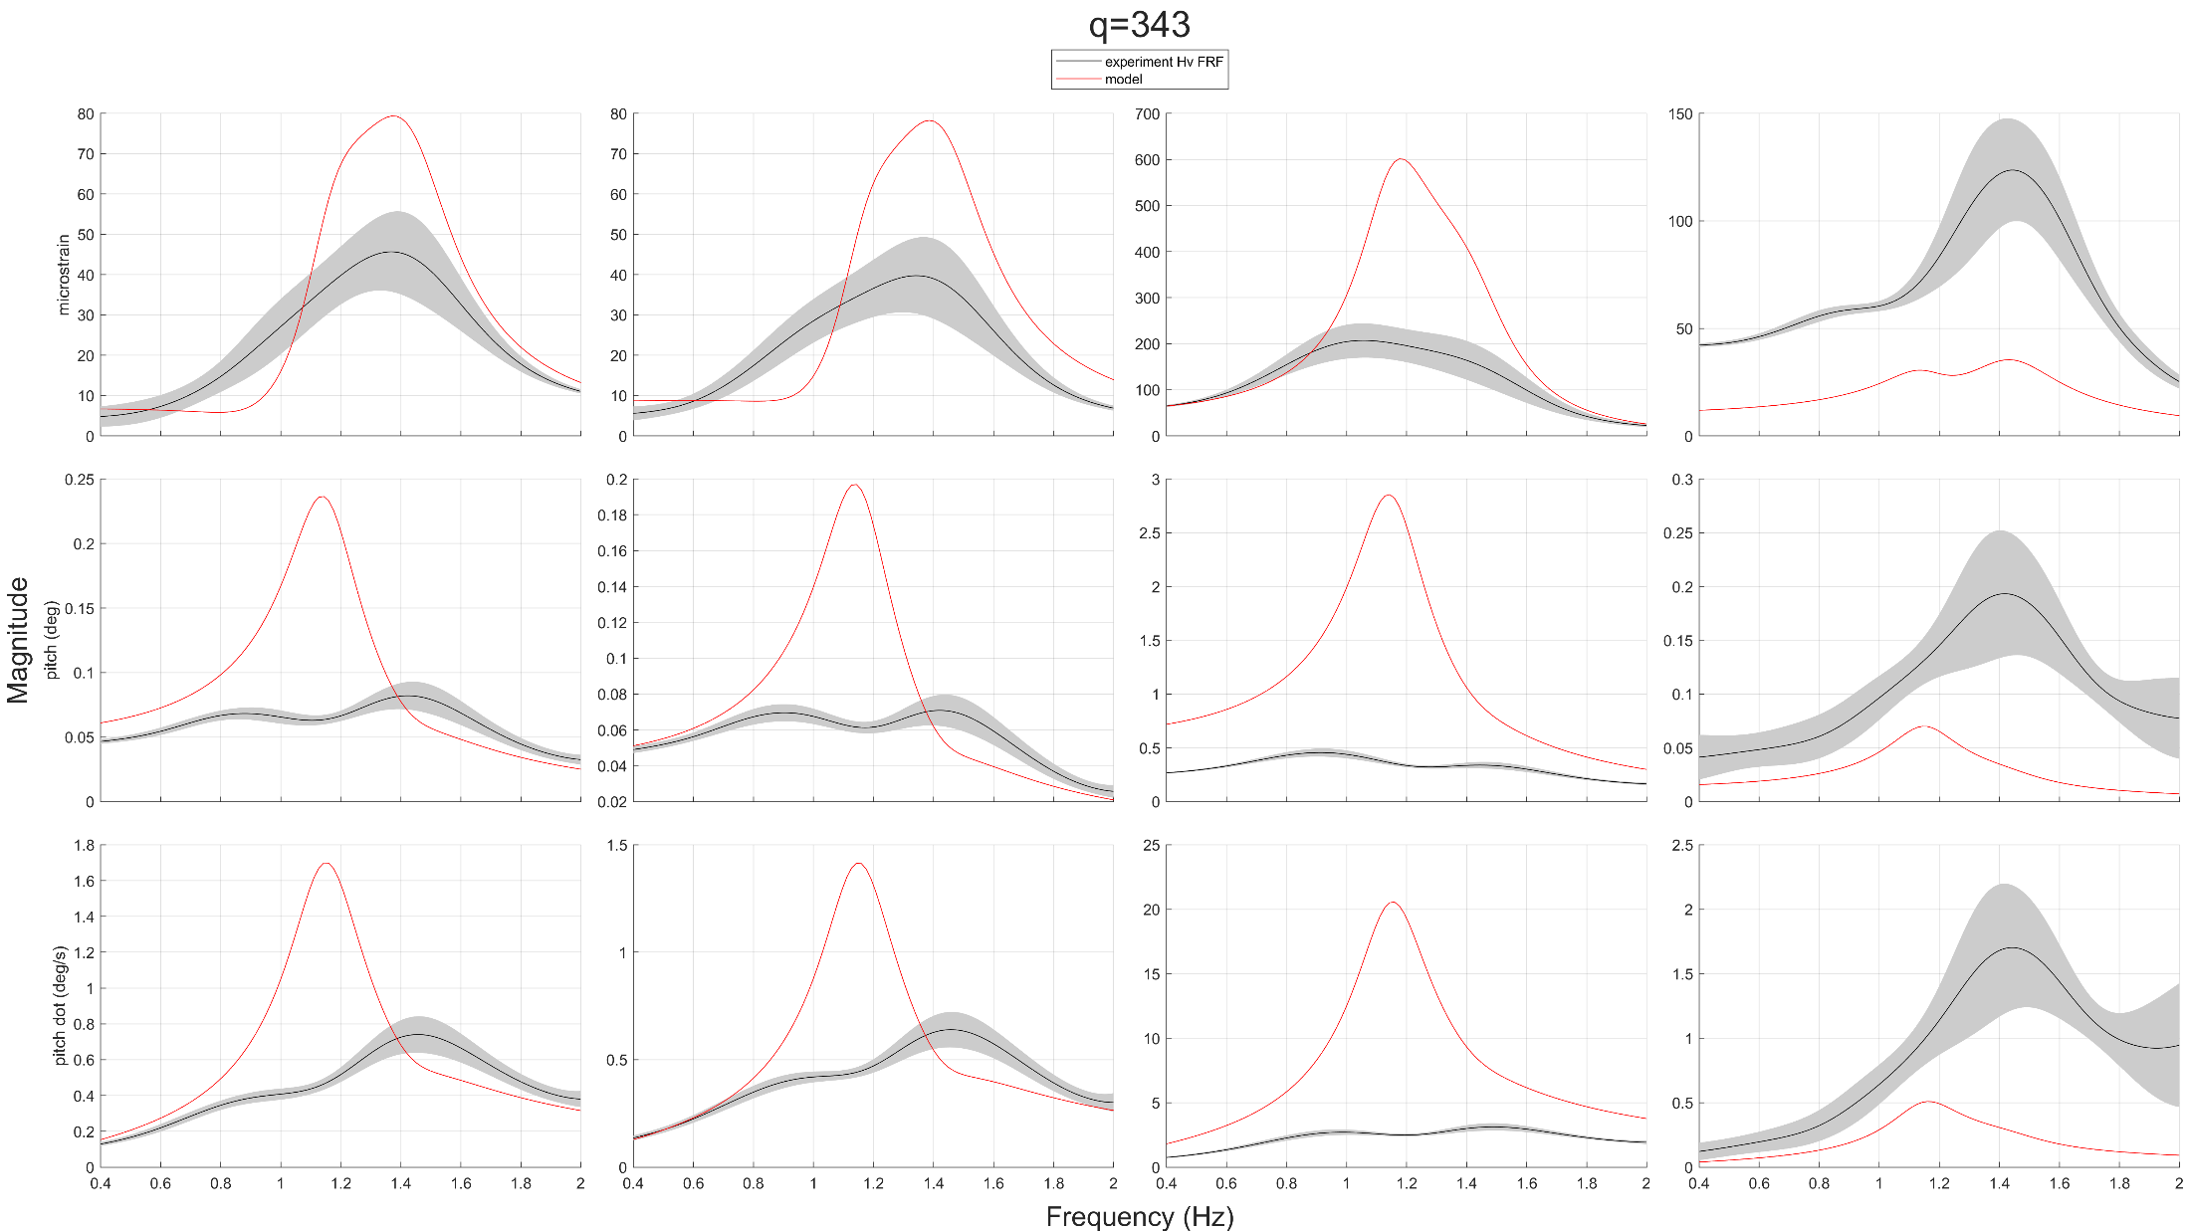
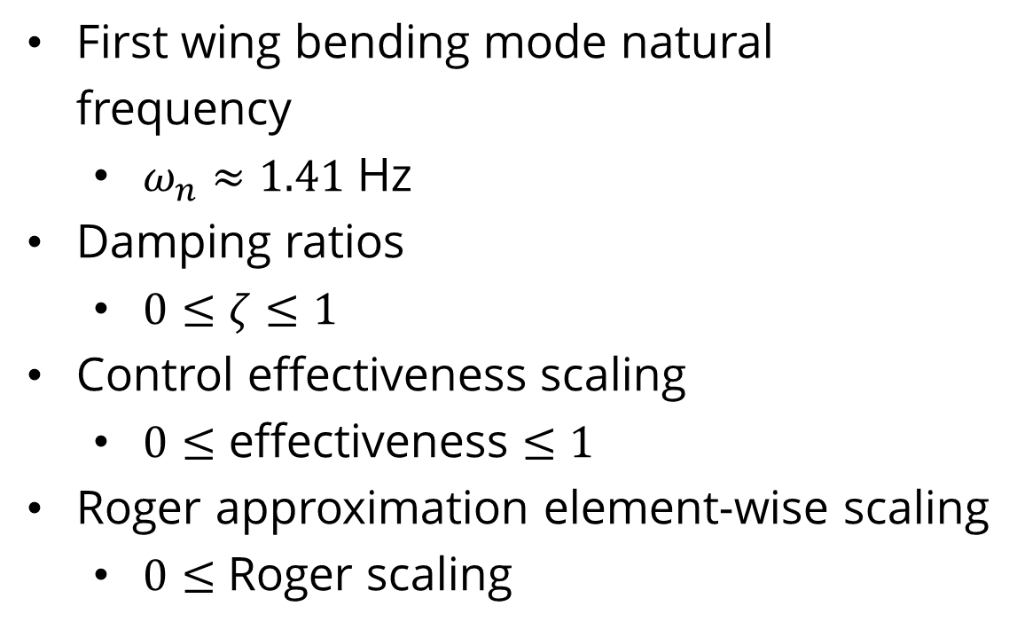
Model Tuning
Tuning Parameters
First wing bending mode natural frequency
$ω_{n}≈1.41$ Hz
Damping ratios
$0≤ζ≤1$
Control effectiveness scaling
$0≤\text{effectiveness}≤1$
Roger approximation element-wise scaling
$0≤$ Roger scaling
Notes:
Tuning parameters
were added into the model to be adjusted to do just that
first wing bending natural frequency
damping ratios of all modes
effectiveness scaling of all controls
element-wise scaling of the Roger matrices that were fitted
these all have a range in which they make physical sense
in structural dynamics, it doesn’t make sense to have a negative damping ratio
it doesn’t make sense for a control to have negative effectiveness
etc.
these will be the constraints that we work in when tunning the model
note: the accelerometer data was deemed too unreliable of a ground truth to fit the model to, so its FRFs are not considered in the tuning process

Slide 32
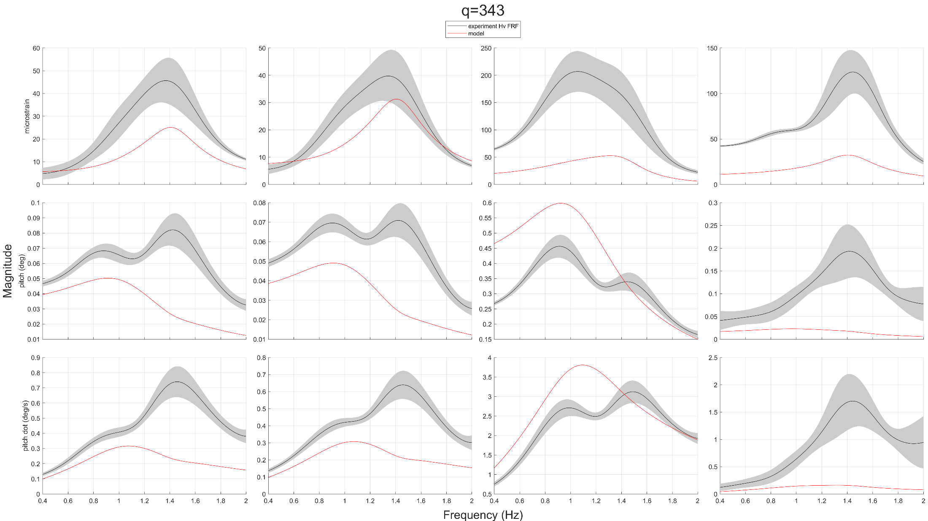
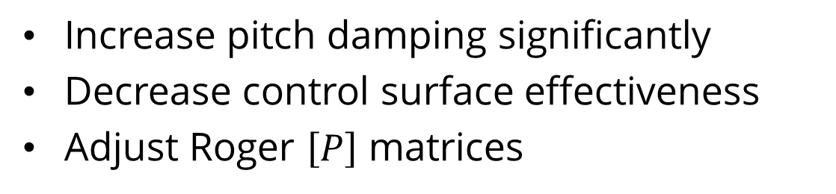
Model Tuning
Hand Tuning
Increase pitch damping significantly
Decrease control surface effectiveness
Adjust Roger $\left[P\right]$ matrices
Notes:
hand tuning
the rigid body pitching mode damping was tuned up a ton
control surface effectiveness was decreased
(as expected to account for viscous aerodynamic effects)
and some entries of the Roger [P] matrices were adjusted
this fit is much better, but still not great

Slide 33
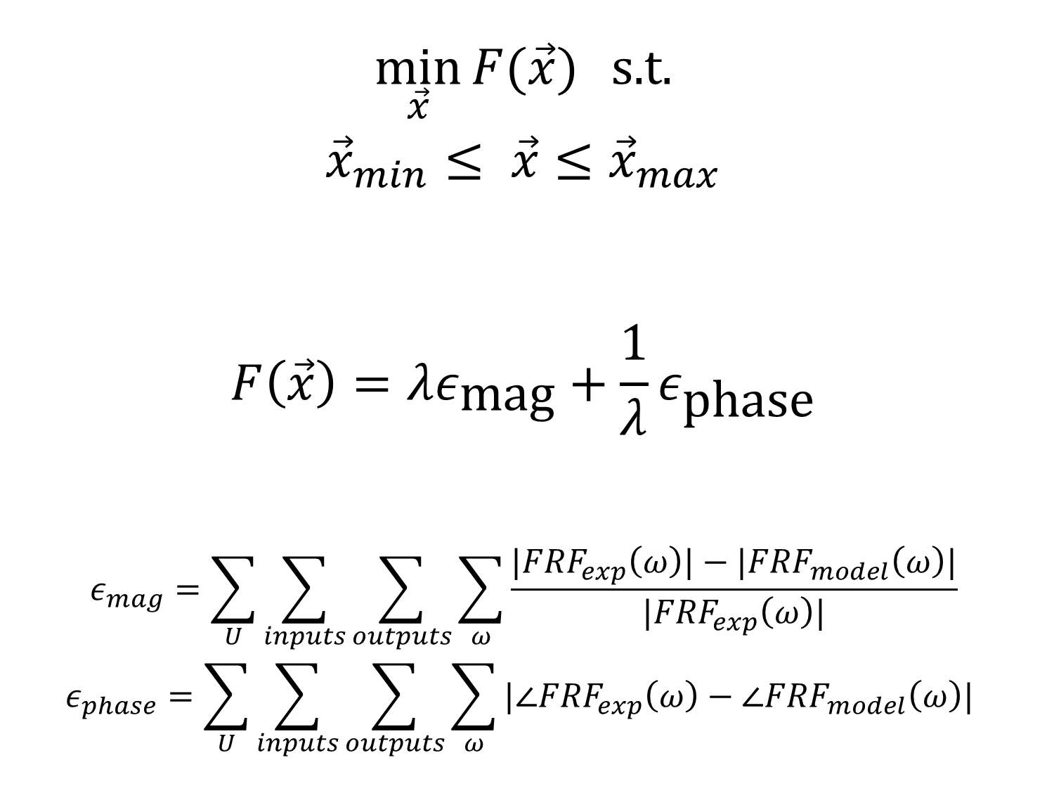
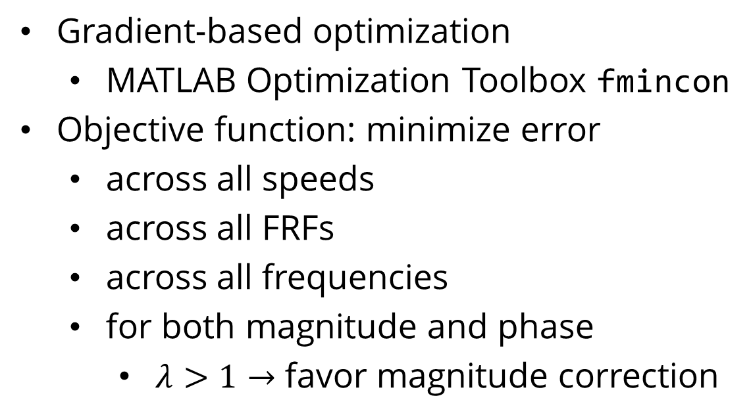
Model Tuning
Optimization
$$\min_{\vec{x}}{F(\vec{x})} \text{s}\text{.}\text{t}\text{.}$$
$${\vec{x}}_{min}≤ \vec{x}≤{\vec{x}}_{max}$$
$$F\left(\vec{x}\right)=λε_{\text{mag}}+\frac{1}{λ}ε_{\text{phase}}$$
$$ε_{mag}=\sum_{U}{\sum_{inputs}{\sum_{outputs}{\sum_{ω}{\frac{|FRF_{exp}\left(ω\right)|−|FRF_{model}\left(ω\right)|}{|FRF_{exp}\left(ω\right)|}}}}}$$
$$ε_{phase}=\sum_{U}{\sum_{inputs}{\sum_{outputs}{\sum_{ω}{|∠FRF_{exp}\left(ω\right)−∠FRF_{model}\left(ω\right)| }}}}$$
Gradient-based optimization
MATLAB Optimization Toolbox fmincon
Objective function: minimize error
across all speeds
across all FRFs
across all frequencies
for both magnitude and phase
$λ>1→$ favor magnitude correction
https://commons.wikimedia.org/wiki/File:Gradient_descent_method.png
Notes:
Optimization
so we turn to optimization to tune the model!
gradient-based optimization using MATLAB
objective function: minimize error
across all speeds
across all FRFs
across all frequencies in those FRFs
for both magnitude and phase of the complex-valued FRFs (epsilon_mag and epsilon_phase)
(phase wasn’t shown in those previous plots we just looked at)
the objective function is a weighted sum of the magnitude and phase error sums
I optimized this with different values of this weight

Slide 34
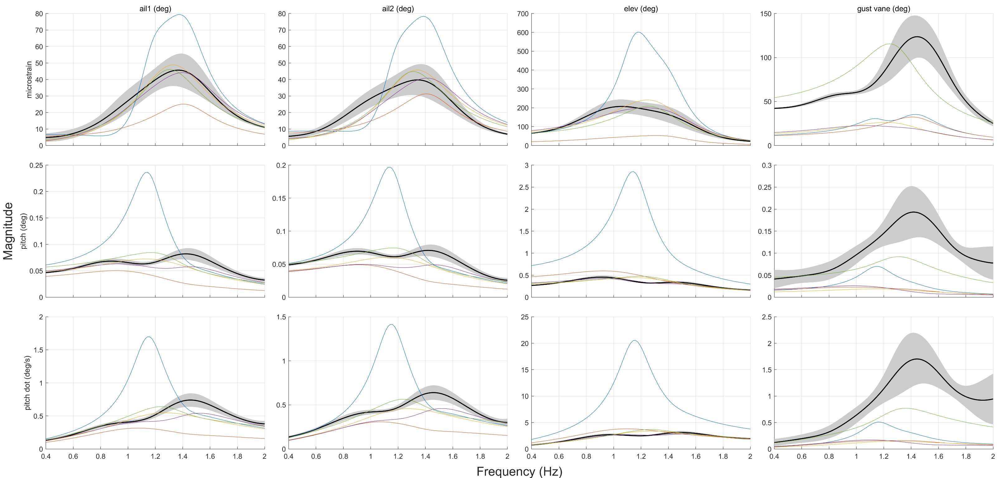
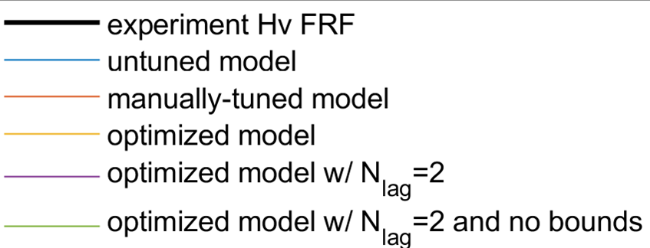
Model Tuning
Notes:
Here are the FRFs for some optimized models, along with the manually-tuned model, not-tuned model, and the experimental data.
(default is ns = 2, nLag = 0)
The optimized models fit quite well!

Slide 35
Future Work
Higher Fidelity Measurement
Extend Modeling Techniques
Design and Test Control Law
Electronically shielded instrumentation
Mode shape measurement
Global optimization
Black-box system ID
Gust load alleviation
Maneuver load alleviation
Active flutter suppression
https://www.m4-engineering.com/wp-content/uploads/2020/04/pynastran-2.png
Notes:
Higher Fidelity Measurement
Electronically shielded instrumentation
MARGE had a lot of sensor signal issues, and electrical interference was suspected to be the culprit for some of it.
Electronically shielded instrumentation could increase the quality of experimental data and thus the model based on it.
mode shape measurement
similarly, inaccurate mode shape information was suspected to be a major contributor to the poor initial performance of the model.
Extended Modeling Techniques
global optimization
two optimization studies I ran, identical except for the initial conditions, reached different solutions
this indicates that the optimization problem may have local minima that the optimization algorithm can get stuck in
this could be alleviated by using global optimization methods such as genetic programming to find the global minimum
black-box system ID
while black-box system identification can be more straightforward to execute in concept, in reality they have some downsides
one is that they often require a reasonably accurate “starting point” in order to converge to the correct solution
the results of my work can generate good “starting points” for this purpose
design and test control law
my state-space model can be used for control law design
gust load alleviation
maneuver load alleviation
active flutter suppression
these active control laws all have the capability of reducing the structural weight required in an aircraft’s structure, and thus increasing performance
if you are interested in this stuff, go see John’s general exam tomorrow afternoon

Slide 36
Conclusion
Mathematical model synthesis
Experimental model validation
Applications in aircraft flight control
Notes:
In summary:
We derived a methamtical model for MARGE
It was adjusted and using experimental data from GVT and wind tunnel testing
The model produced here has applications in Aeroservoelastic flight controls which can increase the performance of aircraft
Before I open to questions, I would like to ACKNOWLEDGE:
my labmates John and Eddie for answering all my questions,
affiliate professor Marat Mor for lending his expertise in finite-element analysis
this thesis wouldn’t have been possible without them
and last but not least professor Livne, who taught me everything I know about aeroelastics
Now I will open it up to the audience for any questions:

Slide 37
References
[1] Jake D. Quenzer, Alison Zongolowicz, Kimberly A. Hinson, Bijan Barzgaran, Eli Livne, Mehran Mesbahi, and Kristi Morgansen. Model for Aeroelastic Response to Gust Excitation. American Institute of Aeronautics and Astronautics Inc., 2019.
[2] Mark B. Tischler and Robert K. Remple. Aircraft and Rotorcraft System Identification, chapter 7. American Institute of Aeronautics and Astronautics, Inc., 1801 Alexander Bell Drive, Reston, VA 20191-4344, 2 edition, 2006.
[3] Kenneth L. Roger. Airplane math modeling methods for active control design. In Structural Aspects of Active Controls, AGARD-CP-228, Aug 1977.

Slide 38
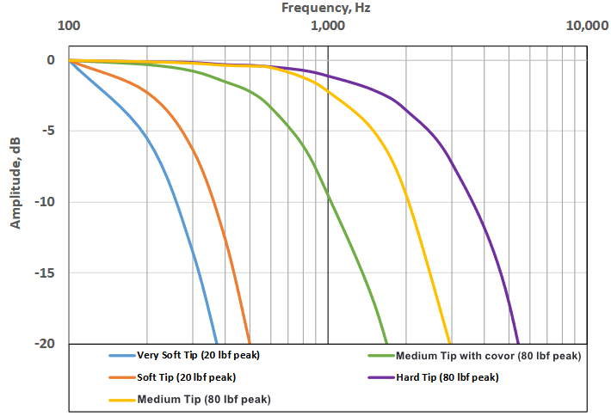
Notes:
I used very soft tip at first which was bad because I was intending to measure up to 200 Hz
I kept on using very soft tip after because I then started decreasing my max freq of interest to practical levels (in the end, maximum area of interest ~20 Hz)

Slide 39
Notes:
why no mode shape measurement?
this is ultimately a modeling study, not a modal testing study. mode shape measurement would be very involved (without a super expensive dedicated system)
MARGE is a low-cost model. It makes sense to use low-cost construction, modeling, measurement, and test.
otherwise, MARGE begins to be an asset which has a lot of value invested into it and then it becomes just as cumbersome to carefully safeguard as a more expensive, high-quality model

Slide 40


ENCODE
SANS

Slide 41
FONT GUIDE
Headings:
ENCODE SANS NORMAL BLACK, ALL CAPS
Alternate headlines and subheads:
UNI SANS BOOK, ALL CAPS
Bodies: Open sans and Open sans bold

Slide 42
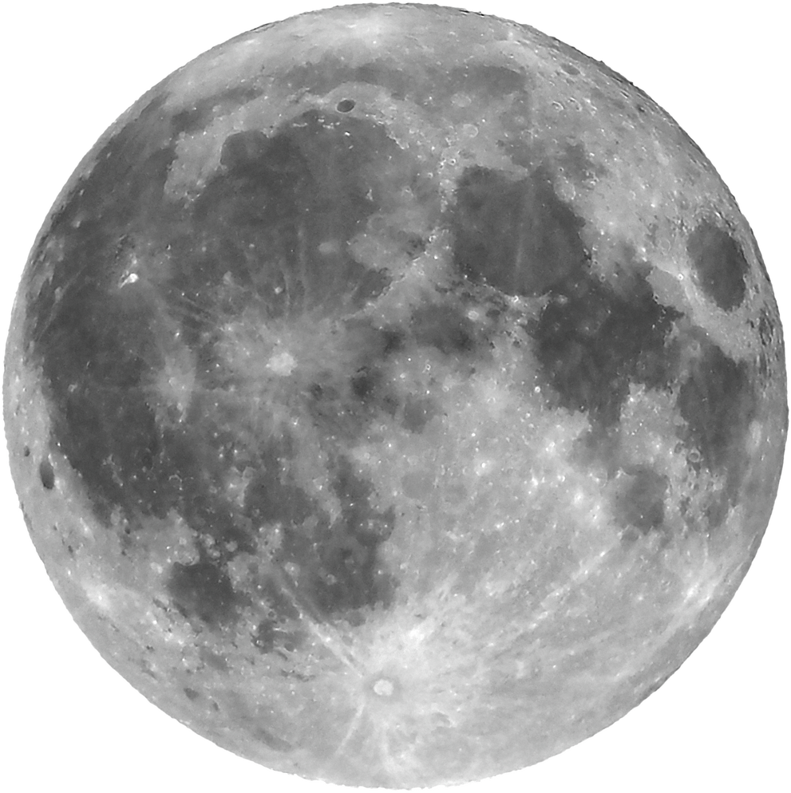
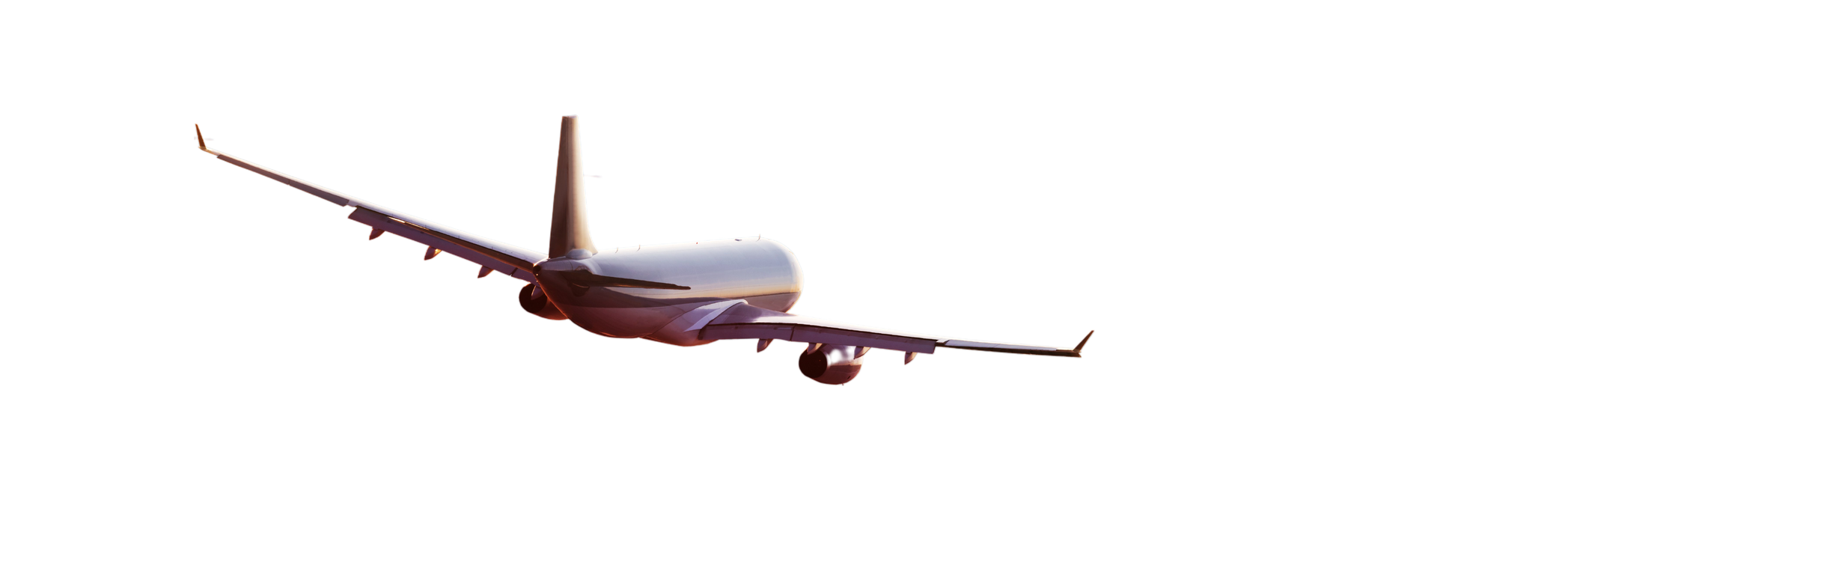
1
Open sans regular body
ENCODE
SANS
2
Or open sans bold body
UNI SANS
(SUBHEADING)

Slide 43
ENCODE SANS HEADING
UNI SANS SUBHEADING
87%
Briefly elaborate on what you want to discuss.
Briefly elaborate on what you want to discuss.

Slide 44
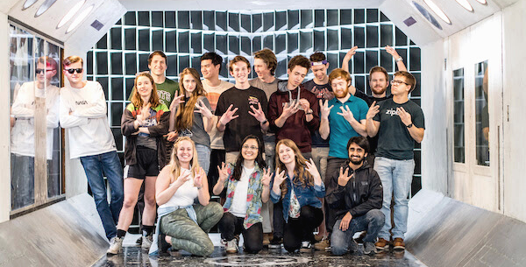


ENCODE SANS HEADING
Open sans body Open sans body Open sans body Open sans body Open sans body Open sans body Open sans body Open sans body Open sans body
1
2
3
Open sans body
Open sans body
Open sans body
Open sans body
Open sans body
Open sans body
Open sans body
Open sans body
Open sans body
Open sans body
Open sans body
Open sans body
Open sans body
Open sans body
Open sans body
Open sans body
Open sans body
Open sans body

Slide 45



ENCODE SANS HEADING
Open sans body Open sans body Open sans body Open sans body Open sans body Open sans body Open sans body Open sans body
UNI SANS
UNI SANS
UNI SANS
Open sans body Open sans body Open sans body Open sans body Open sans body Open sans body
Open sans body Open sans body Open sans body Open sans body Open sans body Open sans body
Open sans body Open sans body Open sans body Open sans body Open sans body Open sans body

Slide 46





ENCODE SANS
UNI SANS SUBHEADING
Open sans body Open sans body Open sans body Open sans body Open sans body Open sans body Open sans body Open sans body Open sans body Open sans body
Open sans body Open sans body Open sans body Open sans body Open sans body Open sans body Open sans body Open sans body Open sans body Open sans body

Slide 47
break

Slide 48

ENCODE SANS HEADING
UNI SANS SUBHEADING

Slide 49
01
UNI SANS
Open sans body Open sans body Open sans body Open sans body Open sans body Open sans body
UNI SANS
ENCODE
SANS
Open sans body Open sans body Open sans body Open sans body Open sans body Open sans body
UNI SANS
Open sans body Open sans body Open sans body Open sans body Open sans body Open sans body

Slide 50

ENCODE SANS HEADING
02
UNI SANS SUBHEADING
Open sans body Open sans body Open sans body Open sans body Open sans body Open sans body Open sans body

Slide 51


UNI SANS
Open sans body Open sans body Open sans body Open sans body Open sans body
UNI SANS
Open sans body Open sans body Open sans body Open sans body Open sans body

Slide 52

03
UNI SANS
Open sans body Open sans body Open sans body Open sans body
ENCODE SANS HEADING
UNI SANS
Open sans body Open sans body Open sans body Open sans body
UNI SANS
Open sans body Open sans body Open sans body Open sans body

Slide 53
break

Slide 54
ENCODE SANS
UNI SANS SUBHEADING
UW AERO AND ASTRO
pg 01 / 22

Slide 55
UNI SANS
UNI SANS
ENCODE SANS
Open sans
Open sans
Open sans
Open sans
Open sans
Open sans
Open sans
Open sans
Open sans
Open sans
03
07
08
09
11
13
14
15
16
17

Slide 56
UNI SANS
UNI SANS
OPEN SANS BOLD
Encode sans heading
UNI SANS SUBHEADING

Slide 57
UNI SANS
UNI SANS
OPEN SANS BOLD
Encode sans heading
UNI SANS SUBHEADING
Open sans body Open sans body Open sans body Open sans body Open sans body Open sans body Open sans body Open sans body Open sans body Open sans body Open sans body Open sans body Open sans body Open sans body Open sans body Open sans body Open sans body Open sans body

Slide 58
UNI SANS
UNI SANS
OPEN SANS BOLD
ENCODE SANS
Open sans body Open sans body Open sans body Open sans body Open sans body Open sans body Open sans body Open sans body Open sans body Open sans body Open sans body Open sans body Open sans body Open sans body Open sans body Open sans body Open sans body Open sans body Open sans body Open sans body Open sans body Open sans body Open sans body Open sans body Open sans body Open sans body Open sans body
Open sans body Open sans body Open sans body Open sans body Open sans body Open sans body Open sans body Open sans body Open sans body
ENCODE SANS
Open sans body Open sans body Open sans body Open sans body Open sans body Open sans body Open sans body Open sans body Open sans body

Slide 59
UNI SANS
UNI SANS
OPEN SANS BOLD
ENCODE SANS HEADING
UNI SANS
UNI SANS
UNI SANS

Slide 60
break

Slide 61




ENCODE SANS HEADING
UNI SANS SUBHEADING

Slide 62

ENCODE SANS
Open sans body Open sans body Open sans body Open sans body Open sans body Open sans body Open sans body Open sans body Open sans body Open sans body Open sans body Open sans body Open sans body Open sans body Open sans body Open sans body Open sans body Open sans body Open sans body Open sans body Open sans body Open sans body Open sans body Open sans body Open sans body

Slide 63


ENCODE SANS
UNI SANS SUBHEADING
Open sans body Open sans body Open sans body Open sans body Open sans body Open sans body Open sans body Open sans body Open sans body Open sans body Open sans body Open sans body Open sans body Open sans body Open sans body Open sans body Open sans body Open sans body Open sans body Open sans body Open sans body Open sans body Open sans body Open sans body Open sans body

Slide 64

ENCODE SANS
ENCODE SANS
Open sans body Open sans body Open sans body Open sans body Open sans body Open sans body Open sans body
Open sans body Open sans body Open sans body Open sans body Open sans body Open sans body Open sans body
ENCODE SANS
ENCODE SANS
Open sans body Open sans body Open sans body Open sans body Open sans body Open sans body Open sans body
Open sans body Open sans body Open sans body Open sans body Open sans body Open sans body Open sans body

Slide 65
ENCODE SANS
ENCODE SANS
ENCODE SANS
Open sans body Open sans body Open sans body Open sans body Open sans body Open sans body Open sans body
Open sans body Open sans body Open sans body Open sans body Open sans body Open sans body Open sans body
Open sans body Open sans body Open sans body Open sans body Open sans body Open sans body Open sans body

Slide 66
break

Slide 67
ENCODE SANS
UNI SANS SUBHEADING

Slide 68
UNI SANS
Open sans body Open sans body Open sans body Open sans body
Encode sans heading
UNI SANS
Open sans body Open sans body Open sans body Open sans body

Slide 69



Encode sans heading
UNI SANS
UNI SANS
UNI SANS
Open sans body Open sans body Open sans body Open sans body
Open sans body Open sans body Open sans body Open sans body
Open sans body Open sans body Open sans body Open sans body

Slide 70
Encode sans heading
01
Uni Sans
02
Uni Sans
Open sans body Open sans body Open sans
Open sans body Open sans body Open sans
03
Uni Sans
04
Uni Sans
Open sans body Open sans body Open sans
Open sans body Open sans body Open sans

Slide 71
50
40
Encode sans
30
20
Opens sans body Open sans body Open sans body
10
0
Item 1
Item 2
Item 3
Item 4
Item 5

Slide 72

Encode sans
Open sans body Open sans body

Slide 73
break

Slide 74

Encode Sans
Heading
Open sans
UNI SANS SUBHEADING
NEXT

Slide 75
OPEN SANS
01
UNI SANS
Encode sans heading
02
UNI SANS
UNI SANS SUBHEADING
03
UNI SANS
NEXT

Slide 76



Open sans
01
Open sans
UNI SANS
Open sans

Slide 77
Encode sans heading
Open sans body
Open sans body
Open sans body

Slide 78
1
2
Encode sans
Open sans body Open sans body Open sans body Open sans body. Open sans body
Open sans body Open sans body Open sans body Open sans body. Open sans body
3
4
Open sans body Open sans body Open sans body Open sans body. Open sans body
Open sans body Open sans body Open sans body Open sans body. Open sans body
NEXT

